Slide 1
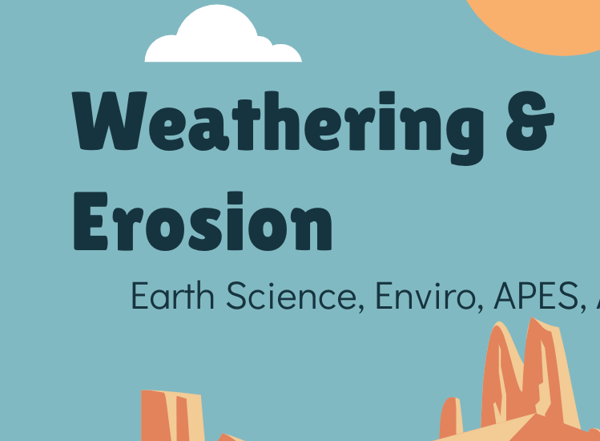
Discovering the Science of the Environment
Weathering & Erosion
Center for Earth and Environmental Science
with support from National Resource Conservation Service

Slide 2
Weathering & Erosion
Earth Science, Enviro, APES, Ag

Slide 3
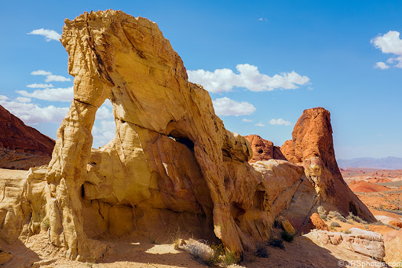
Bell Ringer!
Describe 3 features of the rocks in the picture. Pick features you think are clues to the story of how these rocks are formed.
Valley of Fire State Park in Overton, Nevada
Notes:
This is attempting to get the students to think about erosion and weathering or simply ‘rocks wearing down’
Not super related to farming but maybe an ok bell ringer?

Slide 4
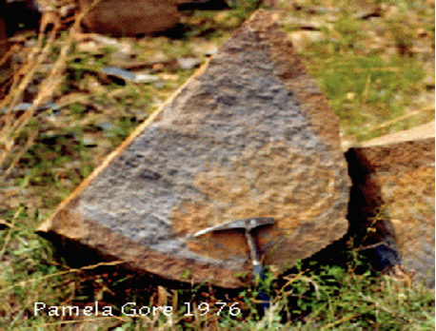
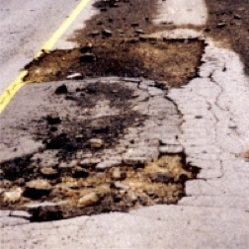
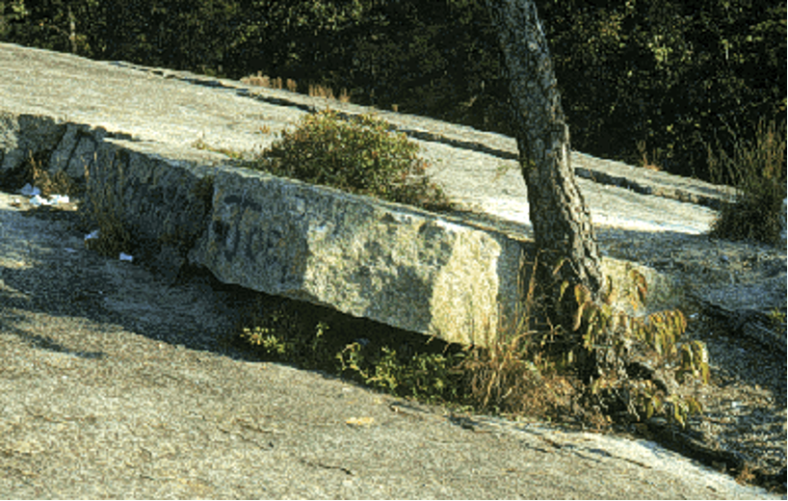
What is Weathering?
The physical and chemical breakdown of rocks at or near the surface
Chemical Weathering
Physical Weathering
Biological Weathering
The chemical breakdown of rock and causes a change in its composition.
Ex: Oxidation- oxygen + iron minerals = RUST
The physical breakdown of rock into smaller pieces, without changing its chemical composition.
Ex: Alternate freezing and thawing of water in roads creates potholes
The physical breakdown of rock caused by plants, animals, and microorganisms.
Ex: Plant roots force their way into cracks

Slide 5
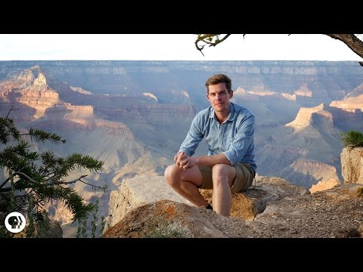
What is Erosion?
Erosion is defined as removal of rocks and soil by wind, water, ice and gravity.
Wind Erosion
Water Erosion
Wind can play a role by carrying material (especially sand and clay) from one place to another.
As the wind blows, it picks up small particles of sand/sediment and blasts large rocks with the sand/sediment, cutting and shaping the rock.
When rain falls to the Earth it can evaporate, sink into the ground, or flow over the land as runoff.
When it flows over land, erosion occurs. Runoff picks up pieces of rock and "runs" downhill cutting tiny grooves (called rills) into the land.
Ex: Grand Canyon

Slide 6
Cause of Erosion: Conventional Farming
Topsoil is hard to replace b/c… it takes thousands of years to form
Plowing causes erosion b/c it clears native vegetation or forests & exposes topsoil
Used b/c it is an easy way to clear land
Impact: causes a loss of topsoil
Things in original soil that can’t be replaced include: trace minerals, earthworms, N-fixing bacteria, and humus.
Notes:
https://www.nrdc.org/stories/soil-erosion-101

Slide 7
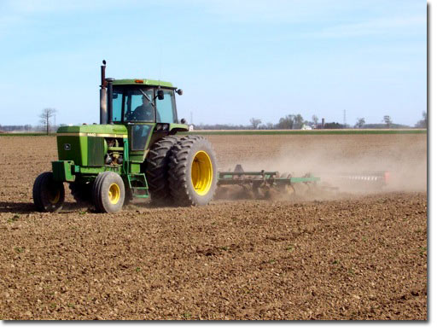
Notice the soil loss behind the plow…

Slide 8
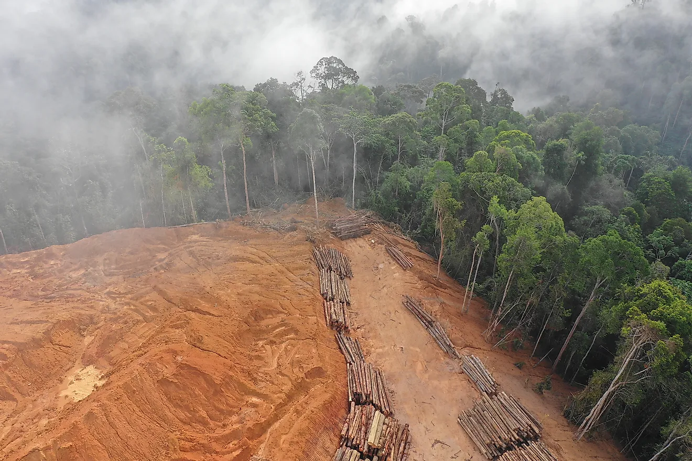
Cause of Erosion: Deforestation
Definition: removal of trees without replanting
Impacts: loss of soil and clogs waterways with sediment (sedimentation)
The roots of the trees that firmly held back the humus-rich topsoil layer helped it to stay firmly in place. Deforestation exposes the soil to wind and water action leading to soil erosion.
Leads to unstable ground
https://www.worldatlas.com/articles/what-is-deforestation.html
Notes:
Unstable ground = unstable infrastructure/buildings on the area and surrounding areas

Slide 9
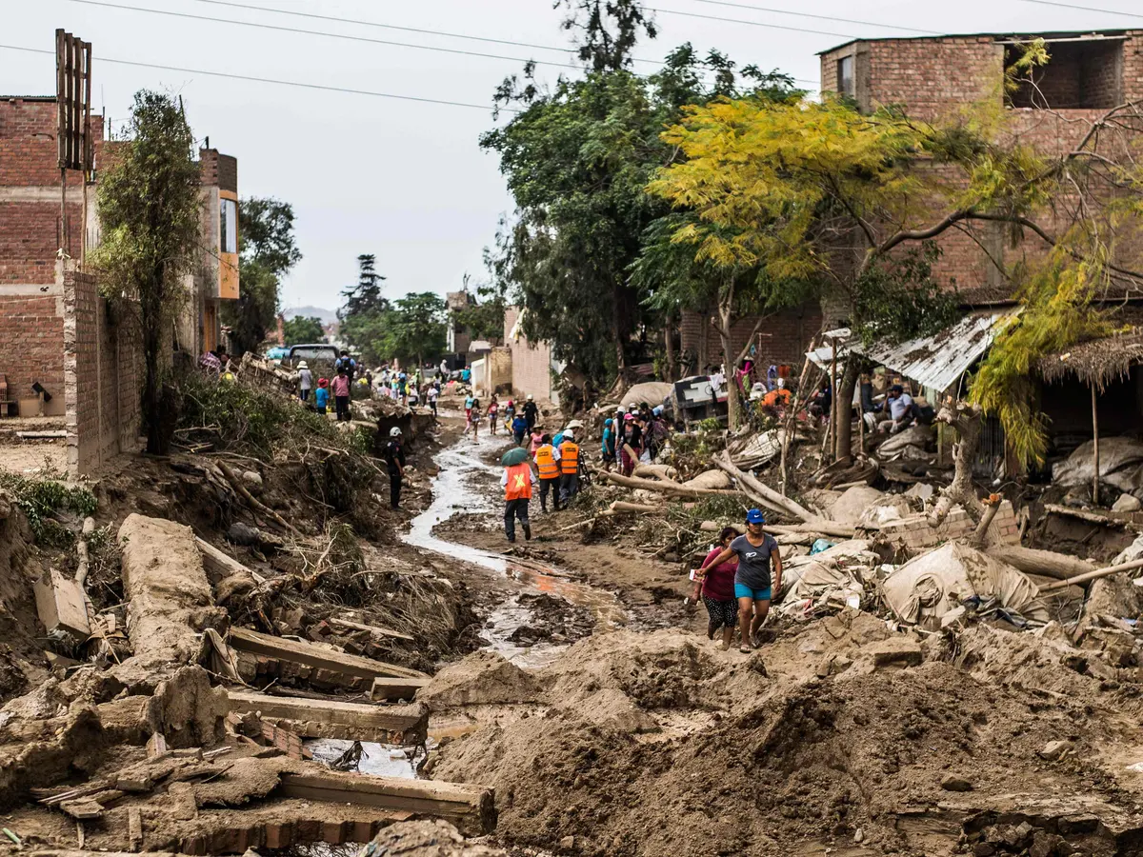
Cause of Erosion: Urbanization
Definition: the process through which cities grow, and higher and higher percentages of the population comes to live in the city.
Impacts:
Natural habitats are lost when forests are cleared & wetlands are filled.
Construction causes the erosion of topsoil.
This is especially true in areas of high densities of people and supporting structures such as roads, homes, and buildings.
Soil and sediment can either be blown or washed away with rain, wind, movement, and disturbance (construction & deforestation).
Once soil is disturbed, the ground will lose strength and be unstable. This loss increases the potential for landslides.
Notes:
It will be easier to see the info on the slide if you present it. I have some animations.
Image: Lima, Peru

Slide 10
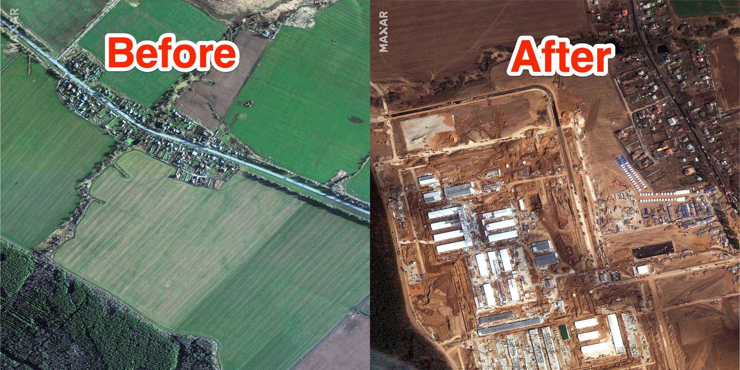
Cont. Cause of Erosion: Urbanization
b. Development takes land away from agricultural use
c. Large volumes of solid waste are produced.

Slide 11
Development of this project was supported by:
Organization
Organization logo
Organization
Organization logo
For more information about the Center for Earth and Environmental Science and the Discovering the Science of the Environment program, go to:
https://cees.iupui.edu

