Slide 1


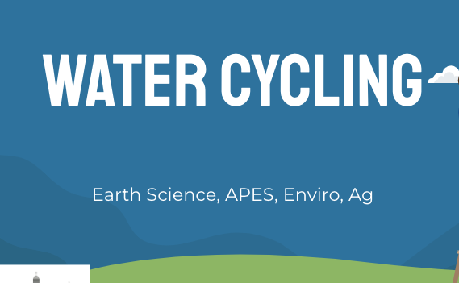
Discovering the Science of the Environment
Water Cycle & Climate Change
Center for Earth and Environmental Science
with support from National Resource Conservation Service

Slide 2

wATER cYCLING
Earth Science, APES, Enviro, Ag

Slide 3
What is the water Cycle?
Team up and draw what you remember about the water cycle.
What causes rain to happen?
Why does water evaporate?
How does condensation happen to form clouds?

Slide 4
Is the water cycle the same everywhere or all year?
How is the water cycle different in the summer?
How is the water cycle different in the winter?
How is the water cycle different in the rainforest (on the equator)
How is the water cycle different in desert?

Slide 5
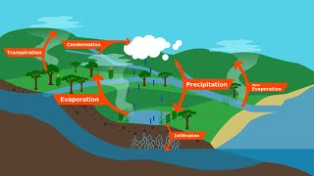

Slide 6
How do changes in the water cycle impact humans?
Think about how the water cycle changes during different seasons, in different places.
How might this impact humans?
On your whiteboards (with partners) write down one way the water cycle changes
(more rain, less rain, rain instead of snow, lots of rain at once…etc.)
Now think about how this will impact the humans that depend on the water cycle. Write down as many impacts as you can think of.
What did you come up with? Share with the class and let’s create a big list of how these changes impact us

Slide 7
drought
How does a drought work
Less rainfall - caused by climate change, change in the jet stream, change in ocean currents and changes in landscape can change precipitation patterns
Soil becomes dry and compacted
When the rain comes it then runs over the top of the compacted soil instead of into the soil to be stored and used by plants.
This can contribute to flash flooding and loss of topsoil
Watch Aral Sea to see how change in landscape can contribute to more drought.

Slide 8
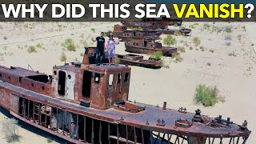
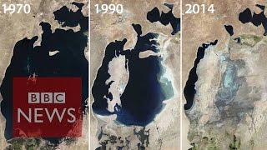
The Case of the aral sea
Notes:
The video on the left is very flashy and will catch the attention of a younger audience. It is the type of media that Generation Z is currently consuming.
The video on the right is from BBC. It shows a more professional and adult look at the Aral Sea crisis.
Depending on your students it would be beneficial to show both videos and talk about why they are different, who is the intended audience, which one is from a reliable source?

Slide 9
The Case of the aral sea
How did diverting the water away from the Aral Sea change the water cycle in that area?
What were the impacts of the sea drying up?
How does this relate to drought in California?
  Is it human caused or natural?
What is desertification and how does it happen?
How does desertification impact the water cycle?
What could humans do to reverse the effects of drought and desertification on the water cycle?

Slide 10
Extreme Precipitation Events & Flooding
Extreme Precipitation: More than 2 inches of rain in less than 48 hours
Caused by:
Increased temperatures on the surface
More heat = more water evaporation
Warm air holds more water = higher relative humidity
When the air FINALLY reaches dew point (cools), it has WAY more water in it than normal
Rains out all at once
In some places can bring a month’s worth of rain in a single day

Slide 11
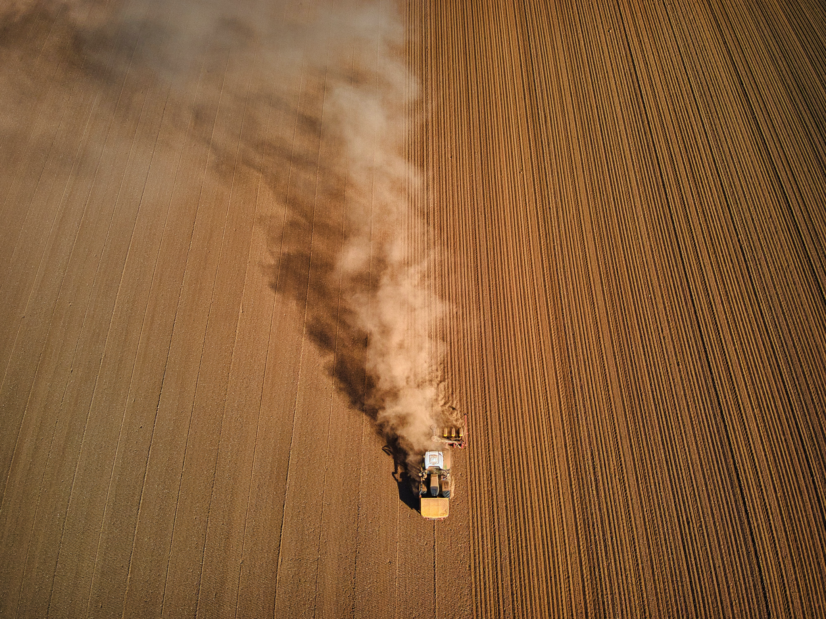
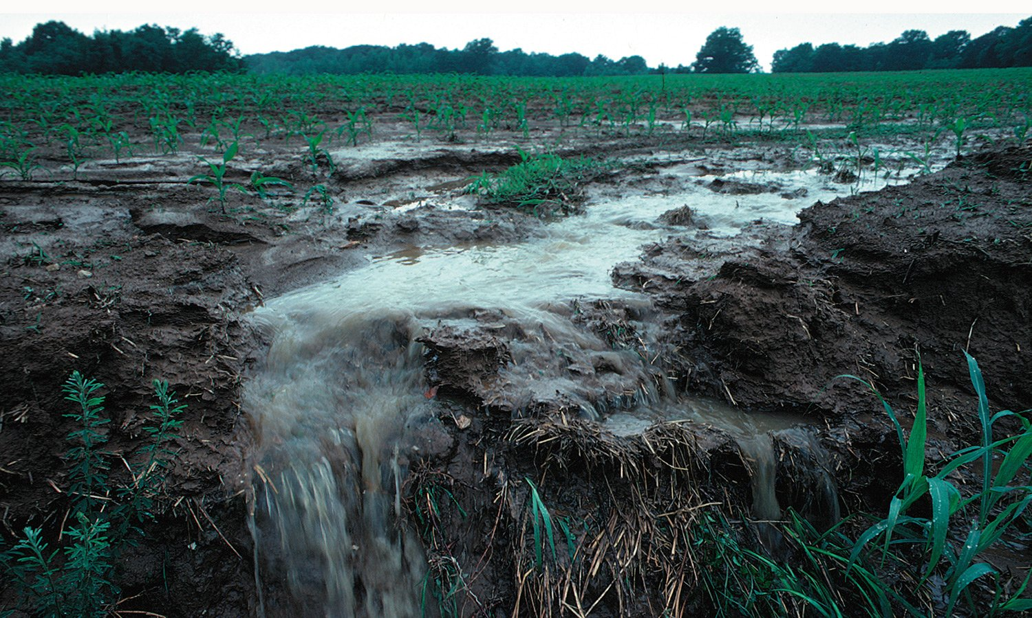
Impact on soil
Remember when we did the food activity and we found how much water it takes to make your food,
Your food is grown in soil if the soil is impacted, then what impact will that have on the food we grow and eat?
Too much water (flooding) can erode topsoil and wash away crops in a short amount of time
Not enough water (drought) and crops don’t grow, top soil can become dry and blow away with the wind

Slide 12
How can farmers adapt to the changes in the water cycle?
Drought Resistance
  Drought resistant crops (GMO’s)
  Cover Crop
  No-till
  Mulching (putting materials over the soil to keep the temp low, and hold water)
  Pasture Management - Prairie restoration
  Irrigation
Flooding Resistance
  Cover Crop
  No-Till
  Natural barriers around fields such as trees, wetlands, and native prairies
  Adequate field tile installation

Slide 13
Crop research Activity - Digital (physical) Poster
Choose a crop that you like to eat - corn, potatoes, strawberries etc.
Research where the crop is grown
Research the crop water needs (what month during the growing season does it need the most water)
Research the average precipitation is for that area during the growing months
What are farmers doing to grow this crop?
Drought resistant crop - irrigation - Field tiles - riparian zones - cover crop etc…
What are the impacts of growing this crop?

Slide 14
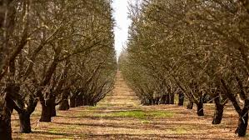
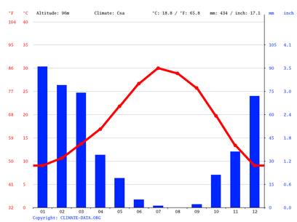
Example crop Poster
Almonds are grown in California
One almond tree needs 1,300,000 gallons of water a year
Almond trees use the most water during the growing season from March to June
Almonds are grown in Fresno, and the most precipitation in the area occurs in the winter months while getting less precipitation in April, May and June
Farmers irrigate this crop with massive irrigations systems, pulling water from aquifers, reservoirs and the Colorado River
The impact of growing this crop is a stress on the water levels of California, especially in drought years

