Slide 1
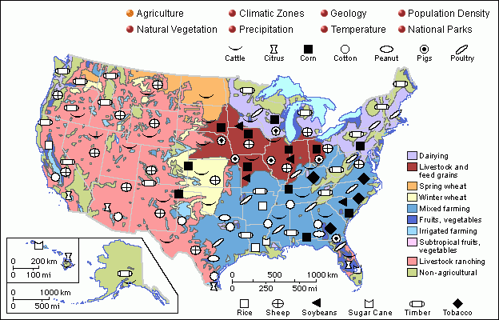
Notes:
Print on Page by itself!

Slide 2
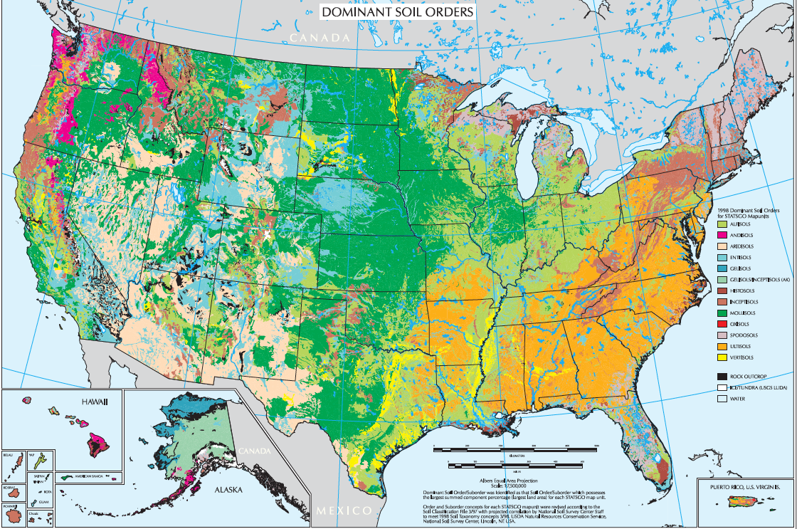
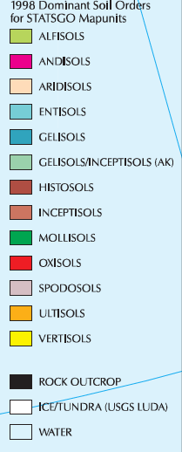
Notes:
Print this map on a sheet by itself.

Slide 3
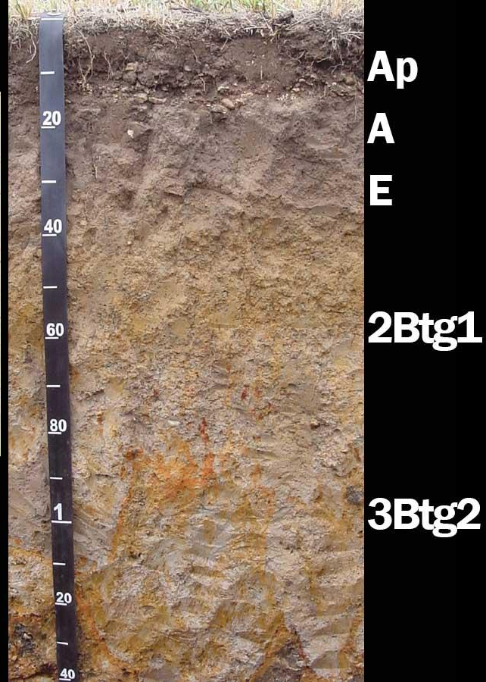
Alfisol
Have a porous top layers that lets water carry nutrients down to other layers. Some alfisols have an O layer if the area has been undisturbed for a long time. These soils are highly fertile. These types of soils are formed in forests. The first meter of soil consists of an A, E and B horizons. After that it transitions into C with the bedrock being 100’s of meters below

Slide 4
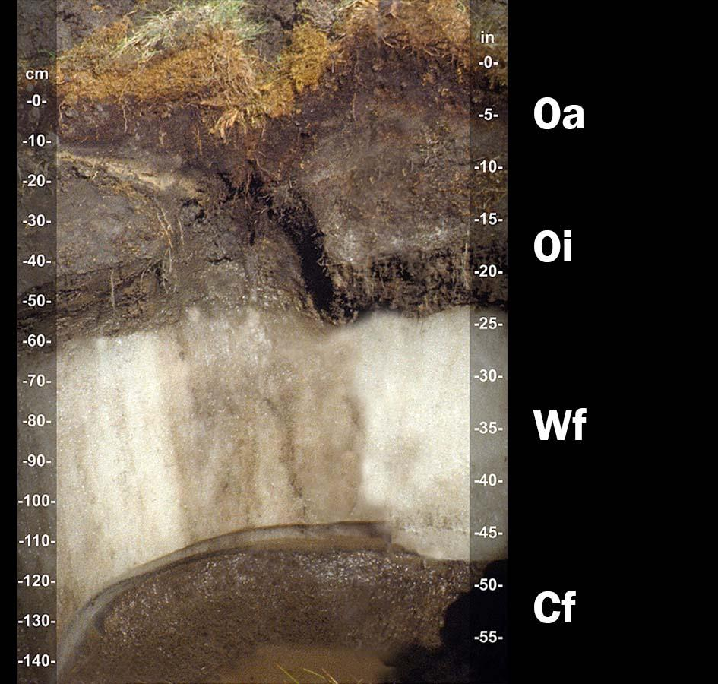
Gelisol
Gelisols are soils of very cold climates that contain permafrost (Wf layer). Gelisols are very old soils with an active organic matter layer on top of the ice, called the active layer. This layers is very sensitive to human activity and is very soft. The layer below the permafrost holds many tons of Carbon Dioxide and is threatened by climate change.

Slide 5
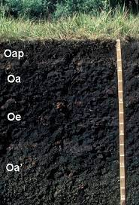
Histosol
These soils are composed mostly of organic matter. The image shows the O horizon down to the first foot. These soils are often referred to as peat and are not good for building on as they can sink easily. Most histosols form in wetlands and swamps. They hold large amounts of carbon dioxide.

Slide 6
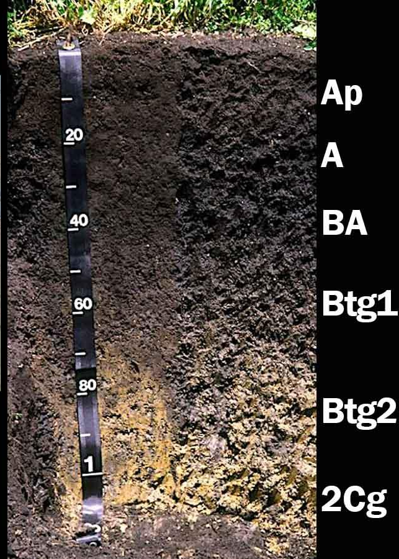
Mollisols
Mollisols are soils of grassland ecosystems. They have a thick dark topsoil (A) horizon. This is formed from the long term addition of organic material. These soils are the most important and productive agricultural soils. These soils mostly occur in middle latitudes such as the Great Plains. However, human farming practices can ruin the topsoil and damage the mollisol.

Slide 7
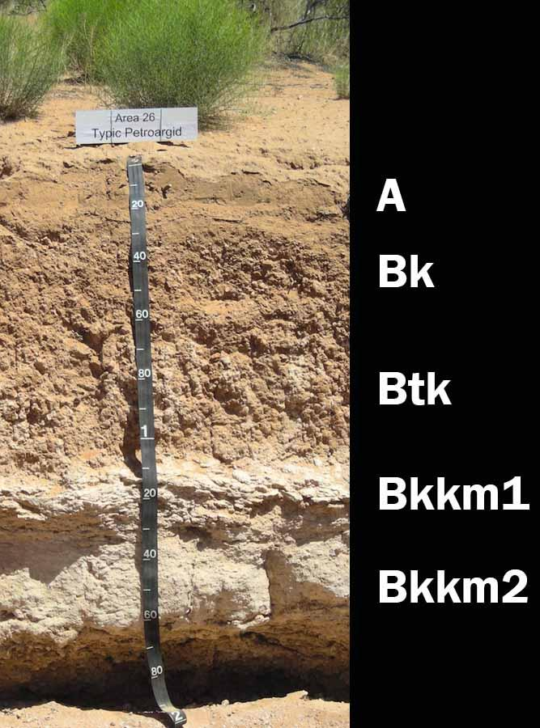
Aridisol
Aridisols are found in arid regions and have a high CaCO3 content. Because there is little precipitation, these soils have all of the nutrients in the very shallow A horizon. The topsoil contain salts which can accumulate over time. These soils do not have much nutrients for crop roots, but are good for rangelands

Slide 8
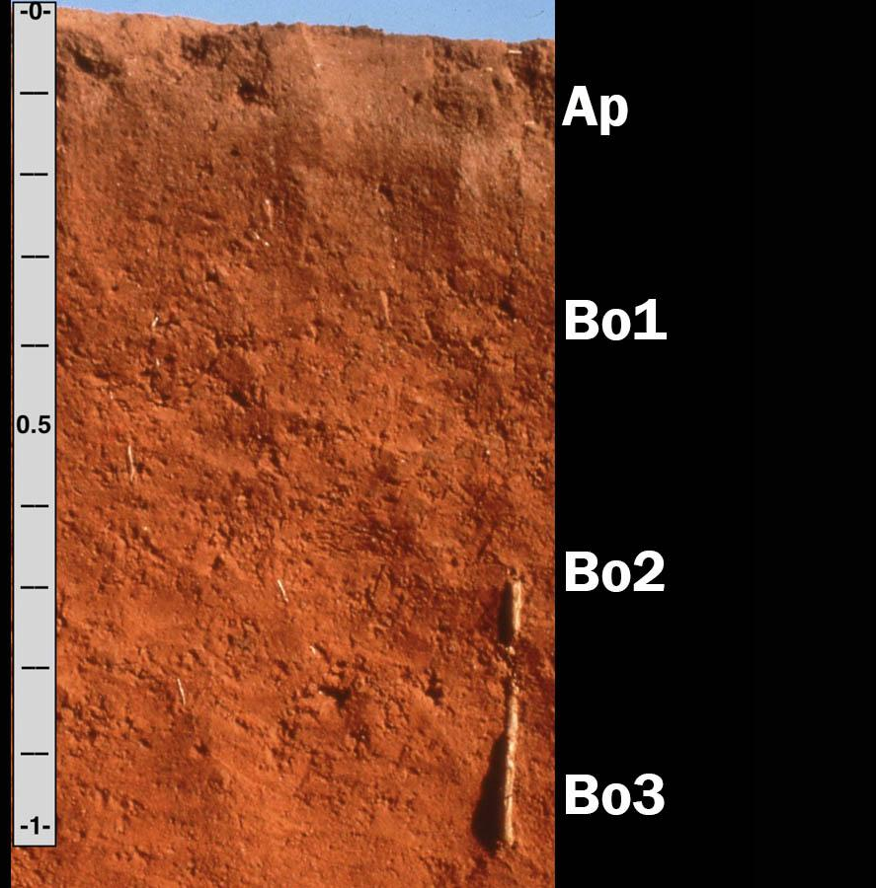
Oxisols
Oxisols are the soils found in the rainforest ecosystems. They have very little organic matter, as the humus is quickly decomposed by microbes and insects. With the amount of precipitation that occurs rainforests, oxisols have very few nutrients in the top layers of the soil. Despite growing large forests, this soil has very low fertility for agricultural purposes

Slide 9
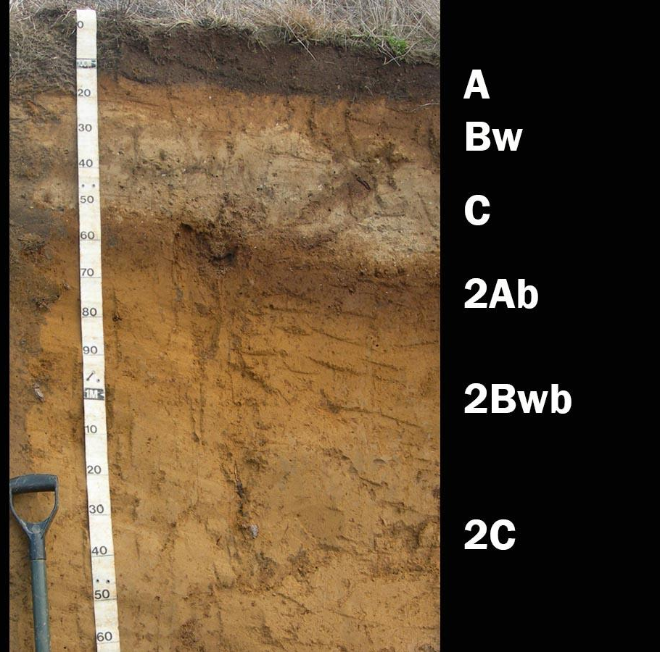
Andisol
Andisols are soils that have formed in volcanic ash. They contain minerals such as silica (glass), and other minerals from the Earth’s interior that have been blasted out of the volcanoes. These soils have a high capacity for holding water and contain large amounts of phosphorus, which acts as a natural fertilizer.

Slide 10
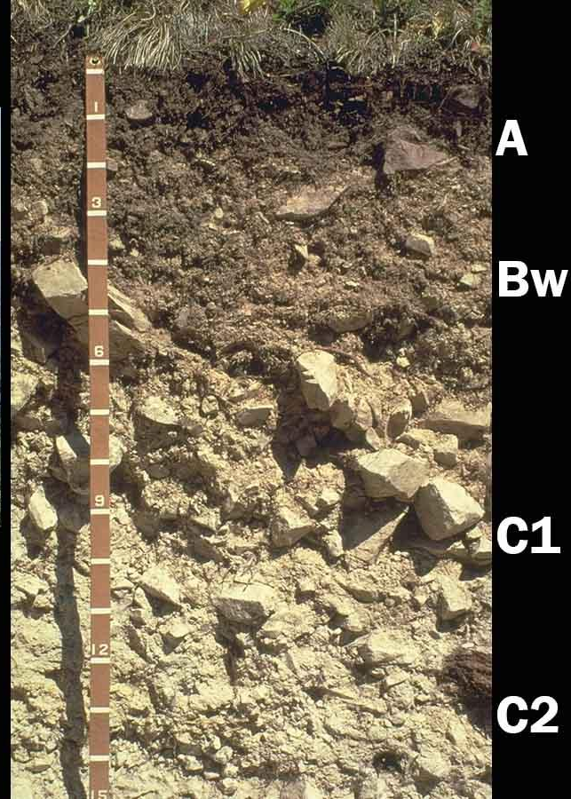
Inceptisols
Don’t really have clear soil horizons. You can see in the image big chunks of the C horizon all the way up into the A horizon. Inceptisols are mostly found on fairly steep slopes, “young” mountains and on hard parent material. These soils are good for forest developments and watersheds.

Slide 11
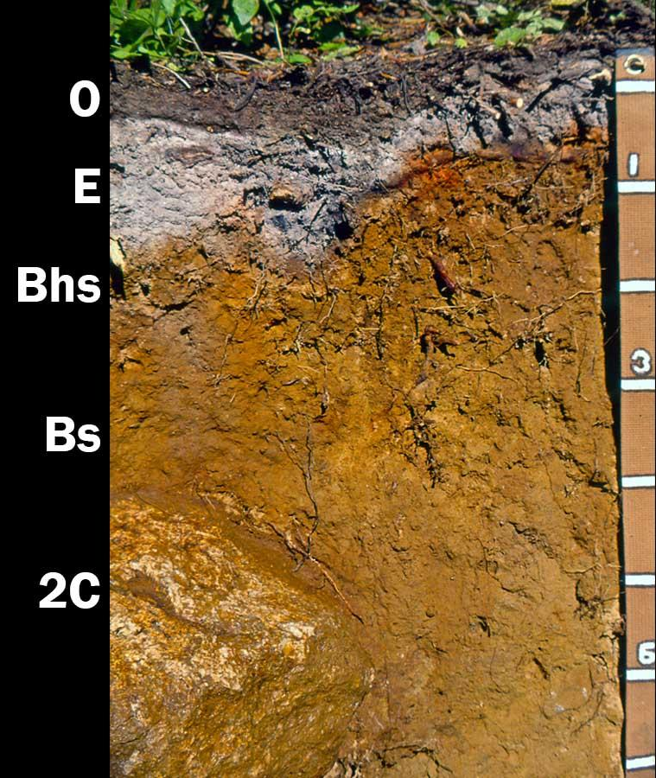
Spodosols
These soils are very acidic and have a deeper O horizon and humus layer. You can see where the minerals have accumulated in the E horizon and it is the ashy gray color. This soil is very good at supporting coniferous forests and can get their acidity from falling pine needles.

Slide 12
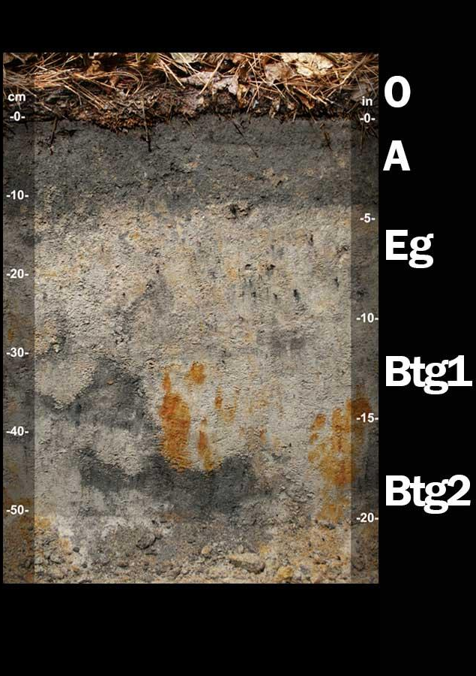
Ultisol
Ultisols are acidic forests soils in places that get a lot of rain. The E layer is larger and many nutrients have been leached way down into the soil by the amount of precipitation. Ultisols often support productive forests. The high acidity and low nutrients make it poorly suited for continuous agriculture without the constant supply of fertilizer.

Slide 13
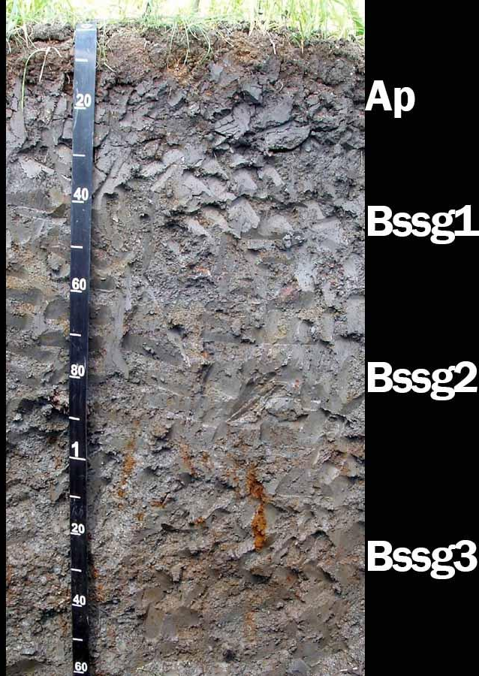
Vertisol
Vertisols are clay-rich soils that shrink and swell with changes in moisture content. During dry periods soils shrink and large cracks form. The soil then expands when water is available. This causes serious engineering issues and people cannot build buildings on this type of soil. There are soil horizons but they are hard to see because the soil mixes from wet to dry.

Slide 14
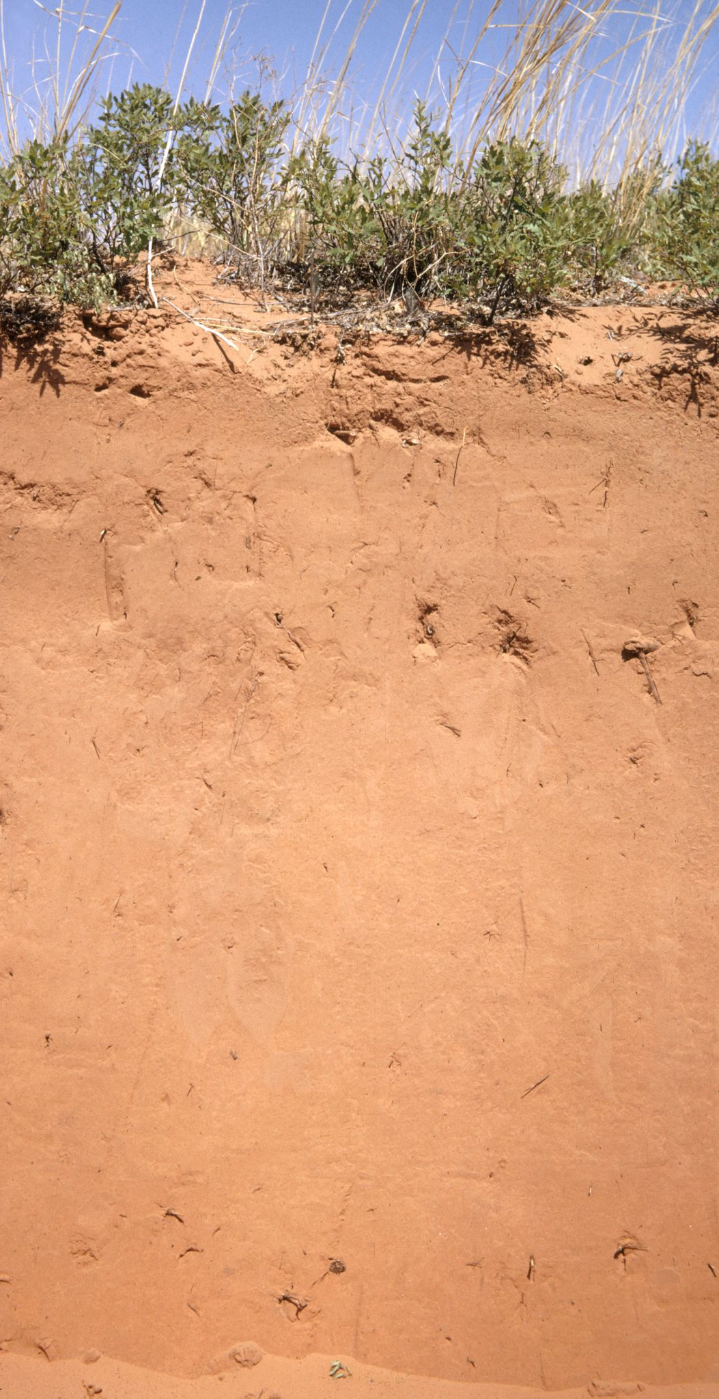
Entisol
Relatively newly formed soil. Has no distinct soil horizons. Many Entisols are found in steep rocky settings. However, some Entisols can be found in large river valleys and are associated with years of eroded river sediments. There can be many different types of entisols, such as sandy, clay, or silt, but there are no layers between types of soil. It’s all one type down to the parent material.

