Slide 1


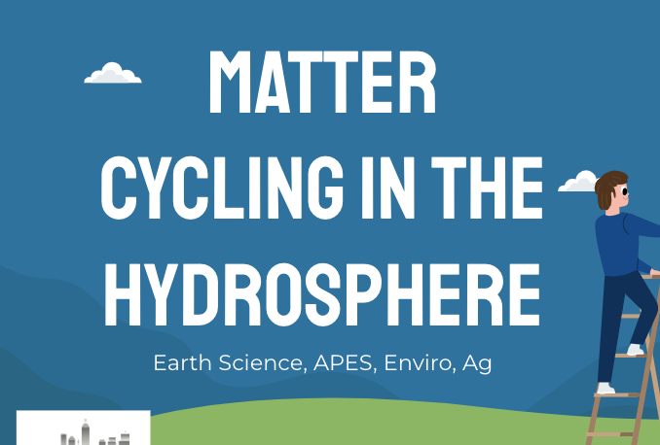
Discovering the Science of the Environment
Matter Cycles in Hydrosphere
Center for Earth and Environmental Science
with support from National Resource Conservation Service

Slide 2

Matter Cycling in the Hydrosphere
Earth Science, APES, Enviro, Ag

Slide 3
Bell Ringer!
Last class we learned about the water cycle. Water plays a part in other matter cycles as well.
Look at the diagrams of the matter cycles and identify how water plays a part in each one

Slide 4
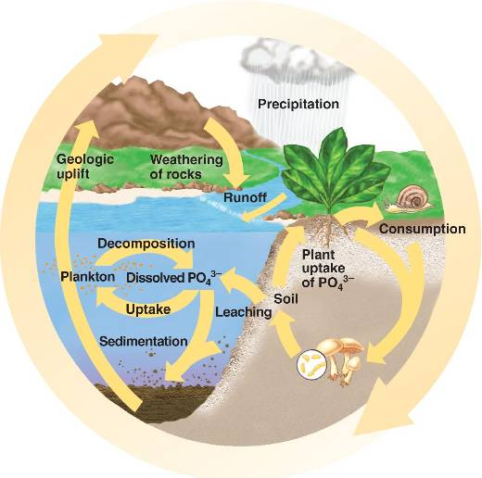
Phosphorus Cycle
Phosphorus is in rocks
Rain weathers the rocks and releases Phosphorus
Water and Phosphorus run over the surface to rivers and lakes
Eventually Phosphorus ends up in the oceans

Slide 5
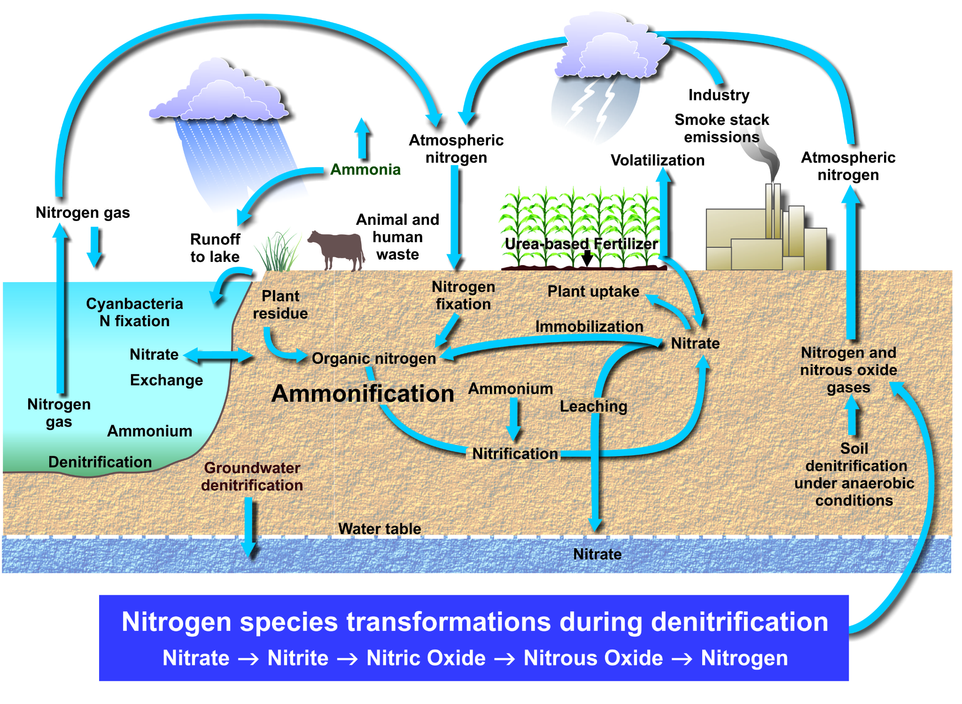
Nitrogen Cycle
Nitrogen comes from the atmosphere and from lightning during a storm
Nitrogen ends up in soil and used by plants
Nitrogen fertilizer is added to plants
Excess nitrogen runs off after a rain into rivers and the ocean

Slide 6
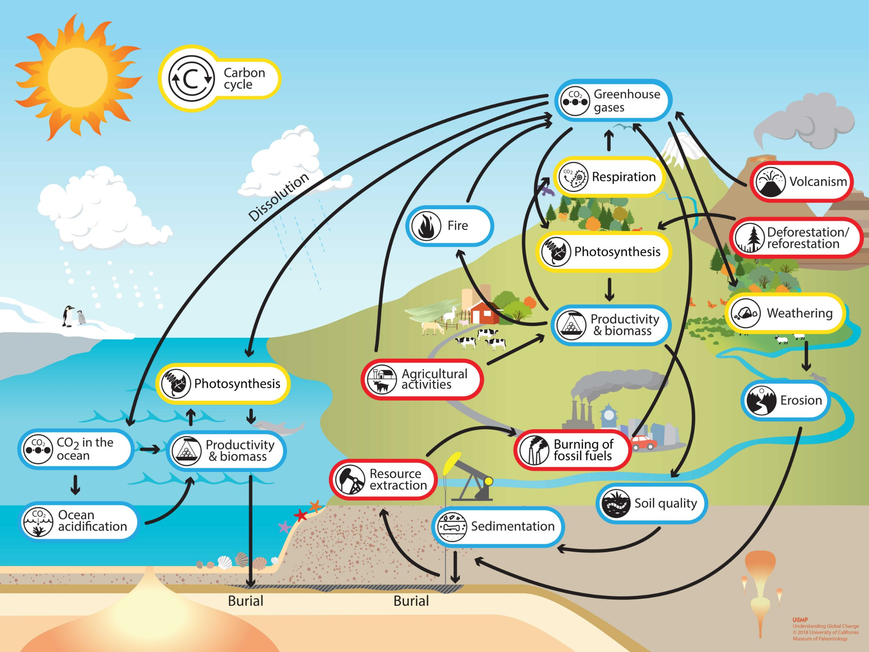
Carbon Cycle
Carbon dioxide is in the atmosphere
Mixes with rain to make acid rain
Acid rain runs over the surface into rivers and the ocean
Carbon dioxide diffuses in the ocean - ocean acidification
Carbon stored in rocks is weathered by rain
Carbon in the atmosphere can be stored in snow layers

Slide 7
Bell Ringer!
Phosphorus, Nitrogen, and Carbon Dioxide in the Earth’s surface water is natural.
They provide water plants and animals with vital nutrients needed for survival
However, humans are impacting these delicate cycles in a big way!

Slide 8
Ocean Acidification

Slide 9
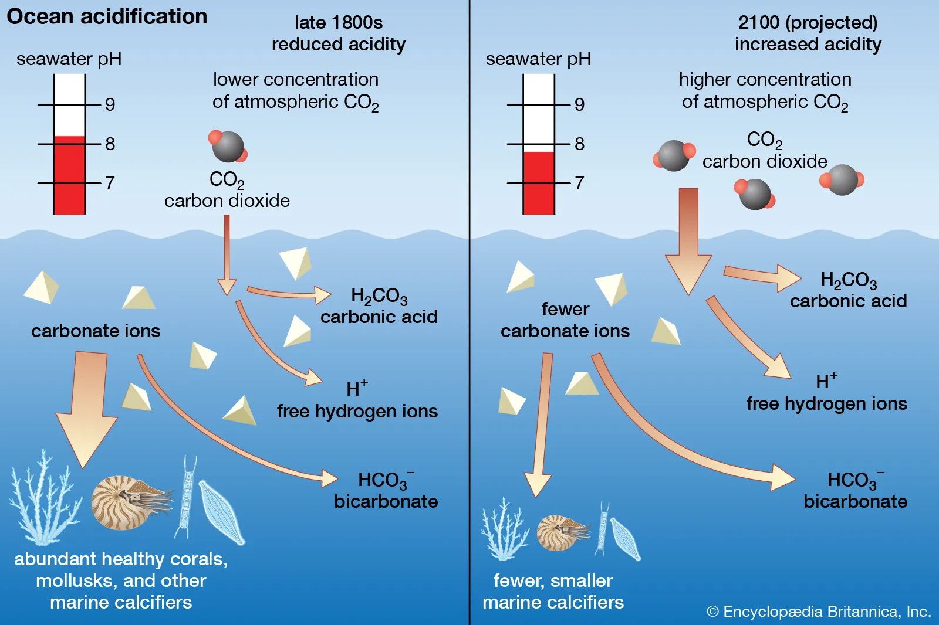
Ocean Acidification
Carbon Dioxide naturally dissolves into water
Before the industrial revolution, the amount of carbon dioxide was used by ocean plants to do photosynthesis
Now there is much more carbon dioxide in the ocean than can be used by plants
CO2 reacts with water to make carbonic acid. This frees up a hydrogen atom
More hydrogen atoms means more acidic
This leaves less carbonate ions for shelled animals, such as coral, nautilus and plankton to make their shells
Shells become weaker and this very important part of the food chain begins to die off
This has impacts on the larger food chain

Slide 10
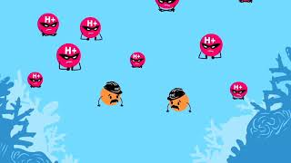

Slide 11
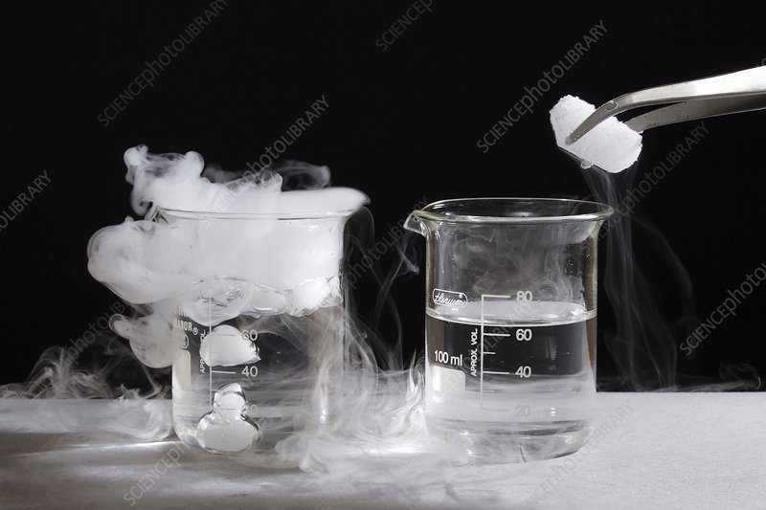
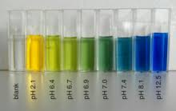
Ocean acidification Lab

Slide 12
Eutrophication

Slide 13
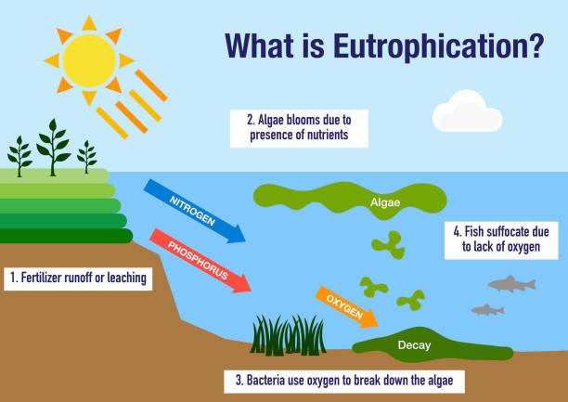
Eutrophication
Nitrogen and Phosphorus are important elements for plant growth
When they get in water sources they help water plants grow, this can cause algae blooms
As algae dies it decays, the bacteria that decomposes algae uses oxygen and produces carbon dioxide
Once the oxygen is used from the water, fish and other water animals suffocate
This can create dead zones

Slide 14
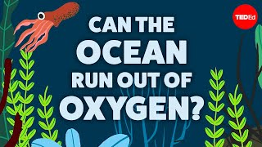
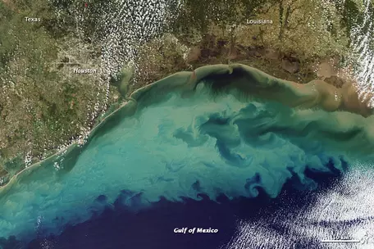
Dead zones

Slide 15
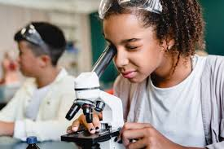
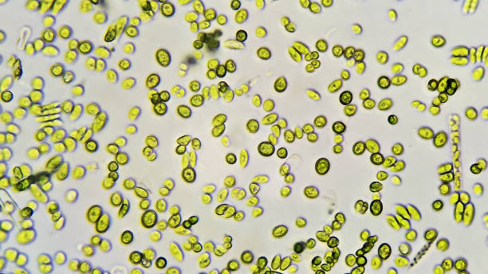
Eutrophication Lab
Or Demo

Slide 16
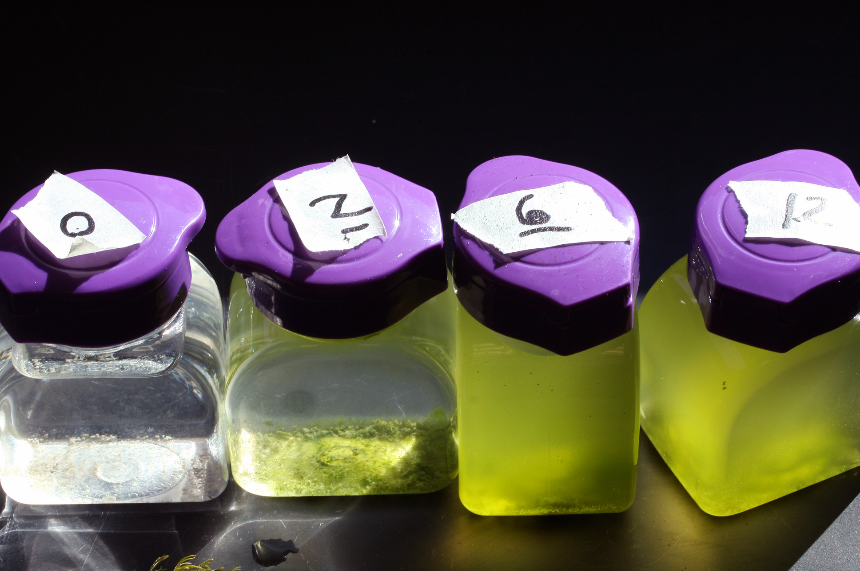
Demo Discussion Questions
Write down observations of the three jars you see in front of you. Make observations based on sight and smell
What do you think has caused the differences in the three jars?
One jar has a pulse treatment - this means it only got one big dose of plant fertilizer, what event in nature do you think this is modeling?
One jar has a press treatment - this means it got 4 smaller doses of plant fertilizer over time. What event in nature do you think this is modeling?
Why do we have to have a control jar?
What is the impact that an algae bloom has on water quality? Would you drink it?
How do you think humans would clean out the algae in order to make this into drinking water?
What other impacts on the water systems can an algae blooms have?

Slide 17
Human impact

Slide 18
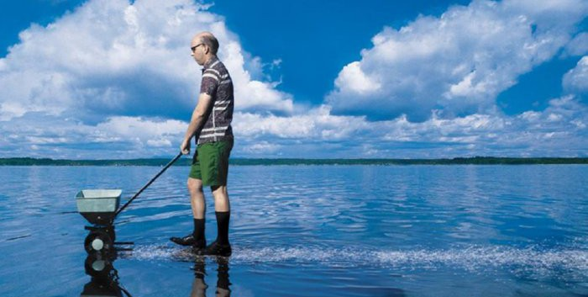
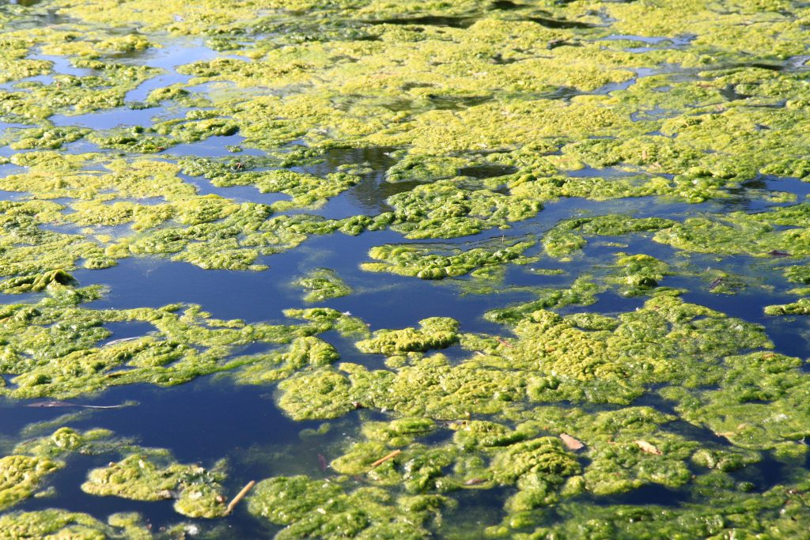
Human Impact
Not only do our crops need water, they also need nutrients
Crops need to be fertilized in order to grow well and produce a high yield
Farmers put fertilizer on the crops - sometimes there is too much fertilizer for the crops to use and it runs off into the water
These excess nutrients cause algae blooms

Slide 19
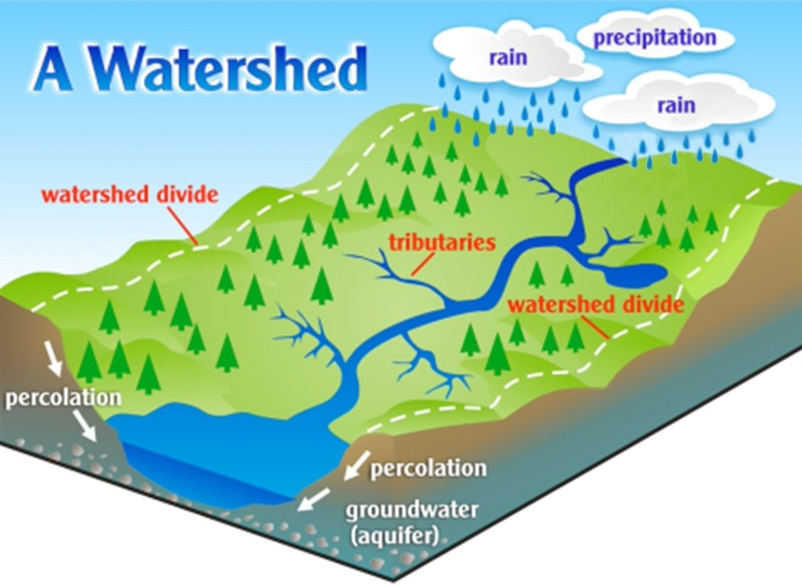
Everything leads to the ocean
You may not live next to a river, but all water eventually leads to the ocean
The water that is used on fields, yards, golf courses, and parks runs into the storm drains and then to the river
Watershed - an area of land that channels rainfall, snowmelt, and runoff into a common body of water - also called a drainage basin
Water flows down!

Slide 20
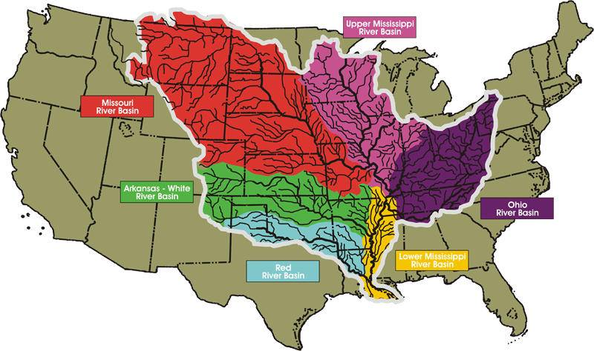
Everything leads to the ocean
Find your watershed - https://mywaterway.epa.gov/
Can you trace the path water takes from your house, or a farm nearby to the ocean?
In Indiana our water flows from the White River, to the Wabash, to the Ohio, then the Mississippi and then to the ocean.
When we use too much fertilizers on our crops, yards, golf courses, and parks it eventually makes its way to the Gulf of Mexico

Slide 21
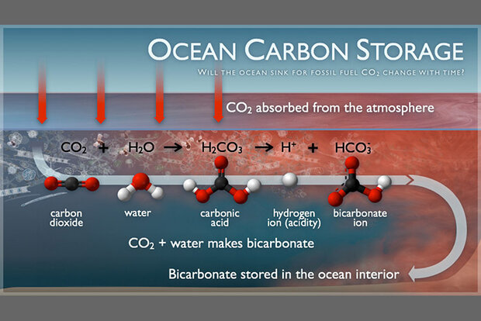
Human Impact
The oceans are a carbon sink!
Remember, Oceans store carbon dioxide from the atmosphere!
This causes the oceans to become acidic
What are humans doing to increase the amount of carbon dioxide in the air, and thereby the carbon dioxide in the oceans
Driving cars
Coal Fired Power Plants
Making plastic
Notes:
I encourage you as the teacher to reach for more than just “burning fossil fuels” Students need to know how those fossil fuels are burned so that they can understand the habits that contribute to this problem. When talking about topics such as human impact, it is important to stay away from vague terms like ‘burning fossil fuels’ and ‘pollution’ as they do not prompt actionable responses

Slide 22
What can we do about this Human Impact?
What can we do to reduce the impacts of fertilizer and carbon dioxide on our water systems?
Split class in half
  One half will research mitigations for reducing eutrophication
  The other half will research mitigations for reducing ocean acidification
  Each table group should have a different strategy, so talk to your neighbors
Research your mitigation strategy and report the following
  Describe the strategy (what are people doing)
  What are the pros and cons of this strategy?
    Is it all good? Why might people not want to do this? Why would people want to do this?
  How do you think cities and states will implement these suggestions? How will they convince the people to do it?
  Is there a cost involved? Time or money?
  Draw how this mitigation strategy will change the phosphorus, nitrogen, or carbon cycle
Notes:
Teachers can do this activity as a white board or poster activity

