Slide 1


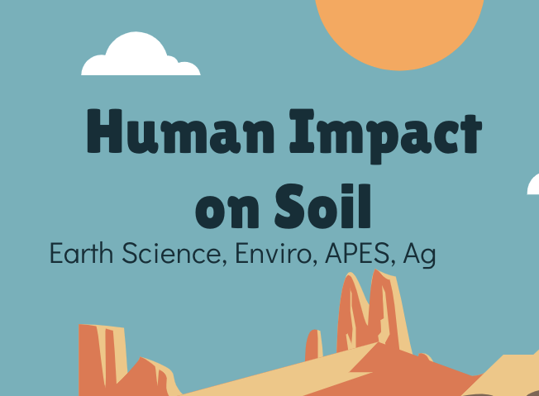
Discovering the Science of the Environment
Human Impact on Soil
Center for Earth and Environmental Science

Slide 2
Human Impact on Soil
Developed by CEES
Earth Science, Enviro, APES, Ag

Slide 3
Bellringer
What steps does a farmer have to go through in order to plant and harvest a crop?
Write down as many as you can think of. Chat with you table
Check out this video of various farm equipment. Is there equipment for every step you wrote down? Is there some equipment missing from the list of steps?
Notes:
https://www.youtube.com/watch?v=ez0_t22eTIM
After the video say: Farmers use all kinds of different methods in order to plant and harvest crops. Today we are going to talk about how some of those methods harm the soil. In addition, we will mention some other soil degradation that is not agricultural related.

Slide 4
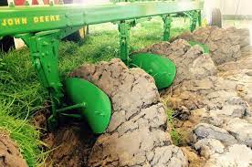
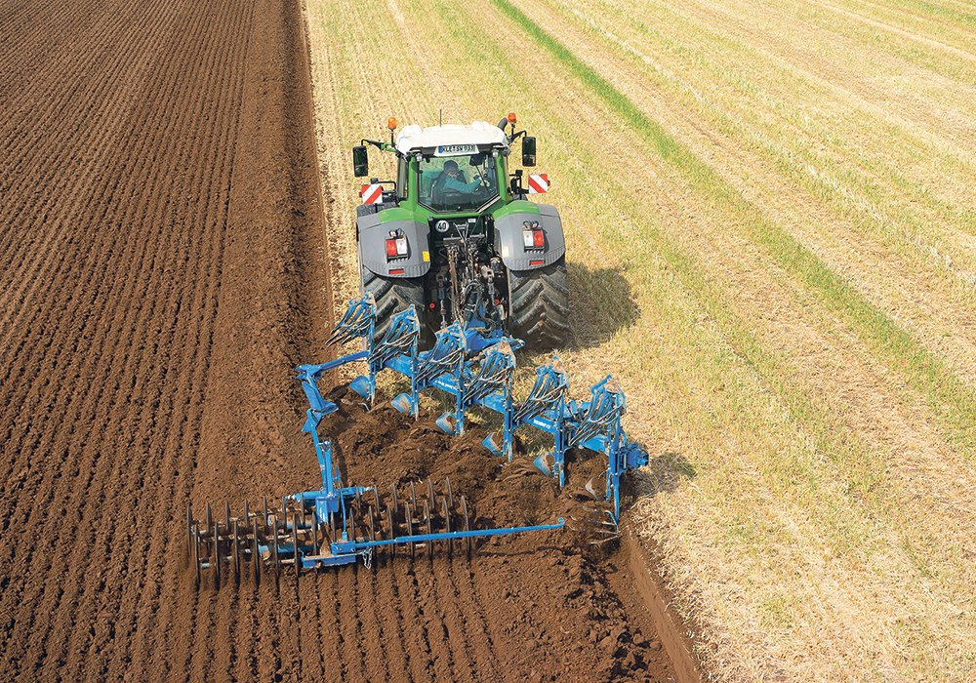
Physical Impacts on Soil
Tilling and Plowing
Breaking up or loosening the soil in preparation to plant.
Think back to your soil health lab…
What aspects of soil health would constant tilling affect?
Notes:
If you have also used the Erosion and Weathering module your students should have covered physical aspects of human impacts. It is nice to review, but go through these slides as best fits your classroom.
The questions are important as they relate back to previous knowledge and help the students see the purpose of the soil testing lab. Tilling the soil affects the density, the porosity, and the ability to stick together. Recall how microorganisms such as fungus work to hold soil together and tilling breaks that up. It also changes the temperature of the soil by decreasing the albedo.

Slide 5
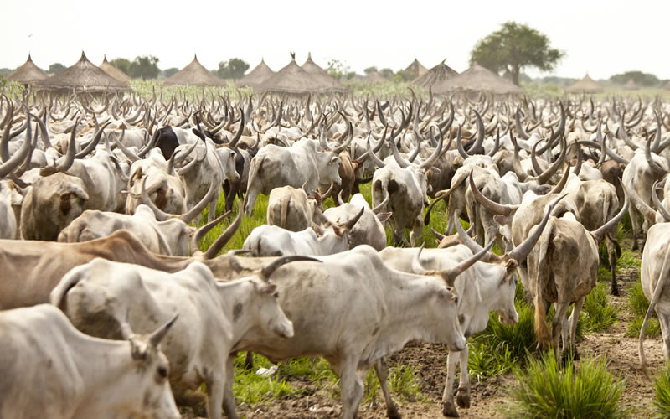
Physical Impacts on Soil
Overgrazing
Livestock animals will eat the grass from an area. In places where livestock are too dense, the natural grasses are depleted leaving room for invasive weeds. In addition, trampling from livestock can compact soils. Also livestock leave behind manure, too much can change the nitrogen and phosphorus levels in the soil.
What aspects of soil health does overgrazing affect?
Notes:
Soil health aspects affected by overgrazing could contain the following answers. Compaction, porosity, killing of native plants might affect soil microorganisms. Manure from cattle can affect soil nutrients which can throw off how native plants grow there later. Invasive roots might not go as deep as native plant roots, changing the oxygen content and the aeration of the soil. Bare soil is left susceptible to erosion which can leach nutrients from the soil.

Slide 6
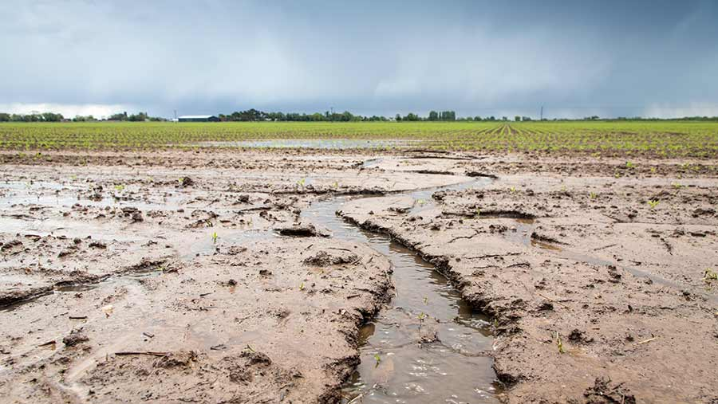
Physical Impacts on Soil
Erosion
Through the removal of plant cover the soil is left open to wind and water erosion.
Wind can break up soil structure and water erosion can leach vital nutrients from the soil as well as displace microorganisms.
What other ways can erosion affect soil health?
Notes:
Can talk about water logging. If the soil is eroded and no longer drains well it can affect plant roots. Plant roots can become waterlogged and decay. In addition vital hummus and topsoil are stripped away.

Slide 7
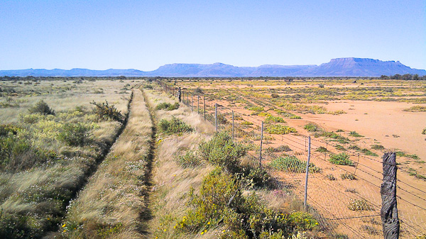
Physical Impact on Soil
Desertification
Desertification is the conversion of arable land into desert. This can happen from the combination of extreme drought and wind erosion. When land is poorly managed desertification can happen.
Think back to the Erosion lessons where we talked about the Dust Bowl.
What farming practices would you recommend to prevent such a disaster?
Notes:
Textbook: Environmental Science a Global Concern, Fourteenth Edition, McGraw Hill

Slide 8
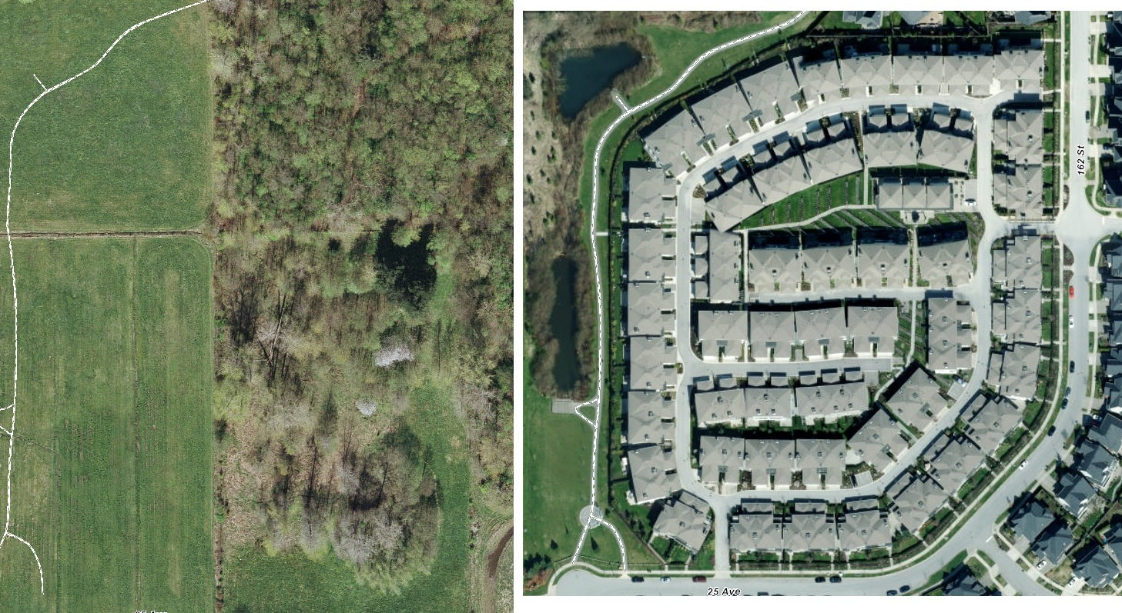
Physical Impacts on Soil
Urbanization
When fields, forests and wetlands are paved over or developed in order to make new living spaces, business and roads.
What aspects of soil health can be affected by urbanization?
Notes:
Students can come up with chemicals left by cars and salting the roads. Soil compaction from paving. Yards which are not natural and can have yard spray or sprinklers.
Changes the temperature of the soil

Slide 9
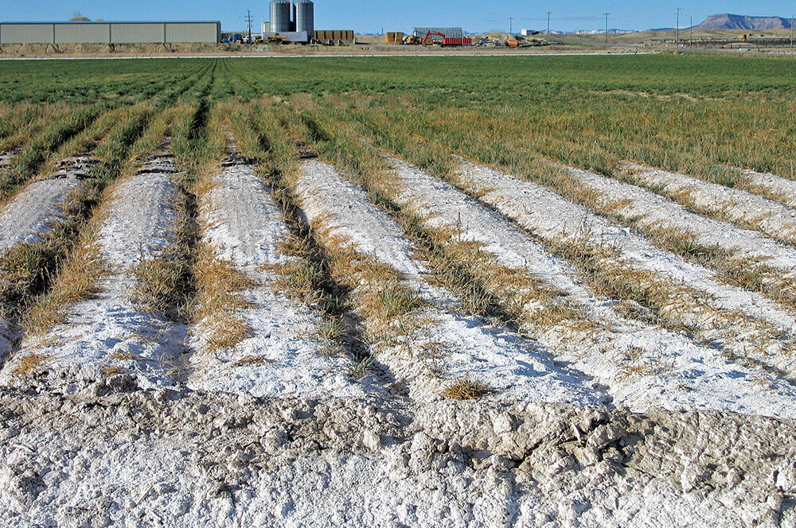
Chemical Impact on Soil
Salinization
Excessive water on the soil, such as from constant irrigation can cause salinization. The water evaporates off the soil and leaves behind minerals. These minerals build up in the soil
What aspect of soil health would salinization affect the most?
Can we reverse Salinization?
Notes:
Textbook: Environmental Science a Global Concern, Fourteenth Edition, McGraw Hill
Salinization affects microorganisms, nutrient uptake of plants, - have students back up their claims with evidence.
Can we reverse it? - https://ensia.com/features/salinization-salt-threatens-soil-crops-ecosystems/

Slide 10
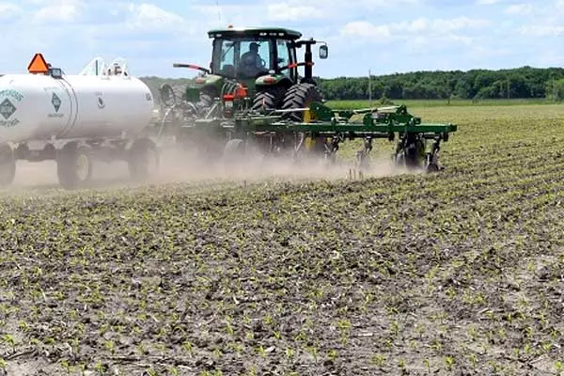
Chemical Impact on Soil
Fertilizers
Commercially created fertilizers contain nitrogen and phosphorus for better plant yield. However, too much of a good thing can be detrimental to overall soil health. In addition, fertilizers can leach through the soil into groundwater and render it undrinkable.
Why might a farmed need to add fertilizer to a field?
Notes:
Recall from a previous lesson in the soil layers lab that there are different kinds of soils and they all have different nutrients available. We need to plant on more than just the best soils. So farmers must make a soil more suitable for planting by adding nutrients.

Slide 11
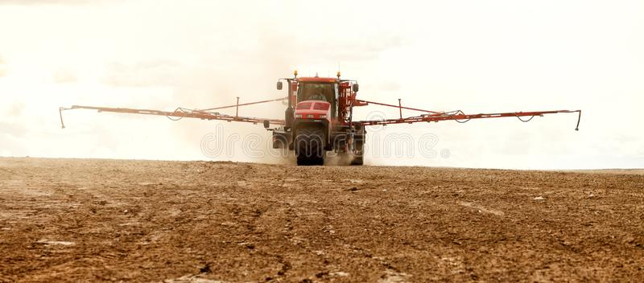
Chemical Impact on Soil
Acidification
Ammonium based (Nitrogen) fertilizers are the main cause of acidification in soils.
Are there some natural alternatives to fertilizers that might reduce acidification?
Take a second to research...
Notes:
https://www.agric.wa.gov.au/soil-acidity/causes-soil-acidity
https://extensionpublications.unl.edu/assets/pdf/g1503.pdf

Slide 12
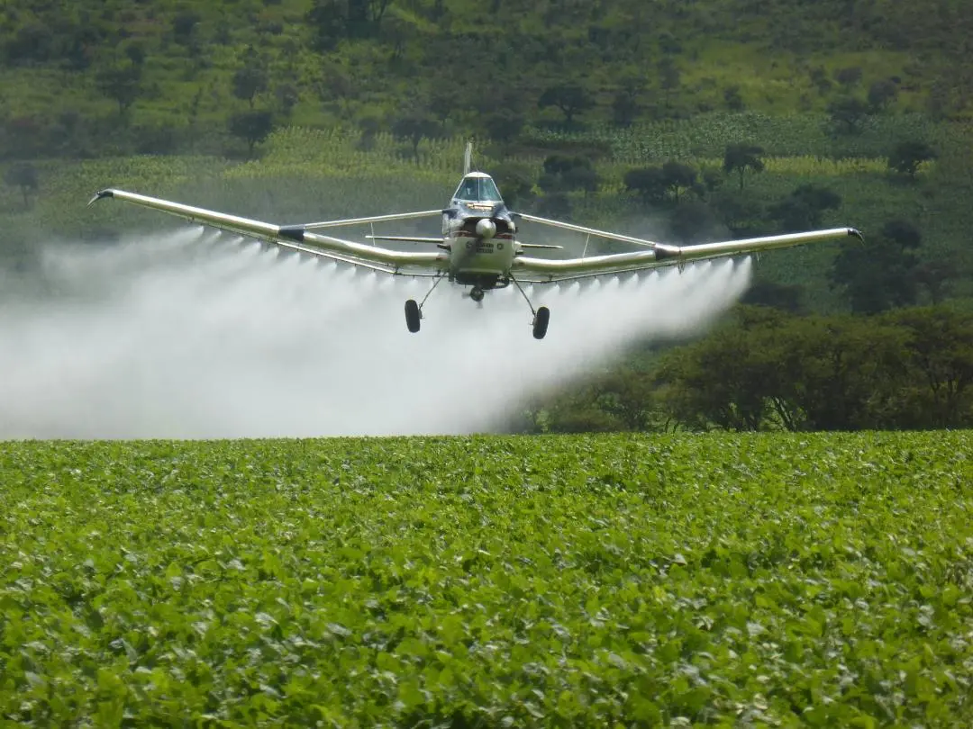
Chemical Impact on Soil
Pesticides
Pesticides are used to cut down on pests that eat and destroy crops. However, the pesticides don’t just stay on the plant, they can leach into the soils and effect soil health.
What is one way pesticides might affect overall soil health?
Notes:
Guide students to think about microorganisms and ways that pesticides might negatively affect them. There are many beneficial insects living in the soil that may be affected by pesticides.

