Slide 1
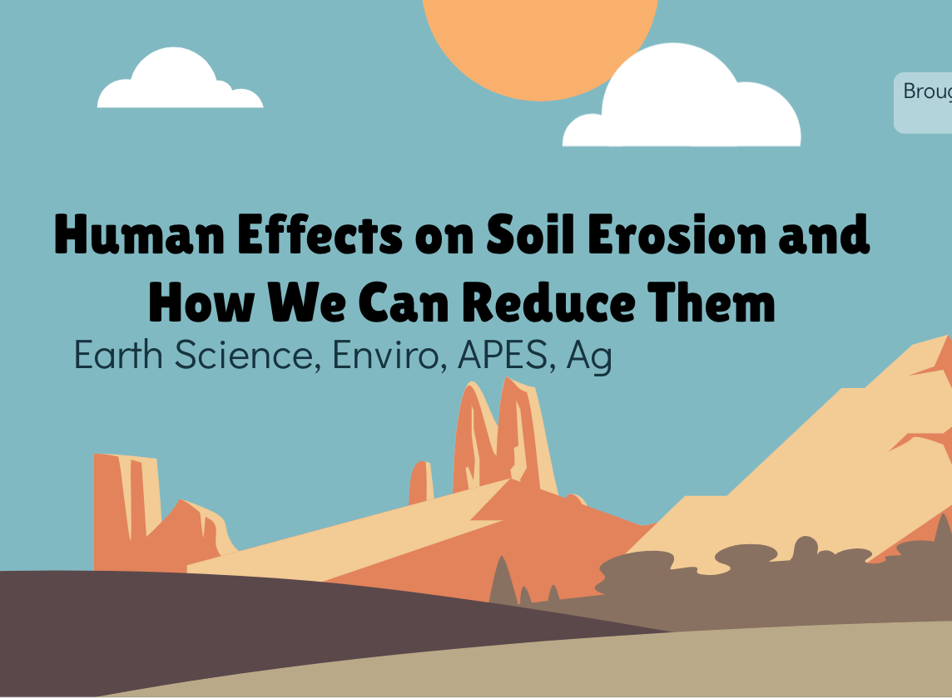
Discovering the Science of the Environment
Human Effects on Soil Erosion
Center for Earth and Environmental Science
with support from National Resource Conservation Service

Slide 2
Human Effects on Soil Erosion and How We Can Reduce Them
Brought to you by CEES
Earth Science, Enviro, APES, Ag

Slide 3
Human Effects on Soil Erosion
Conventional Farming → less food production
Urbanization → Deforestation/Less agriculture fields → Unstable ground and landslides

Slide 4
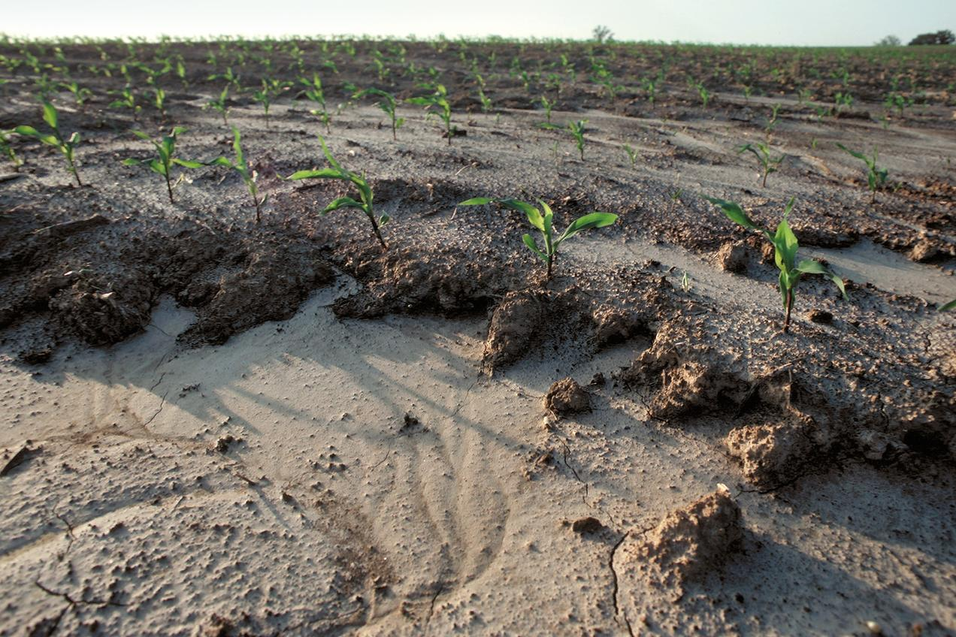
Conventional Farming → Erosion → Less Food
What is conventional farming?
Standard farming techniques that disrupt the soil.
Includes:
plowing & tilling
pesticides
factory-made fertilizers
monoculture
Impact: Leaves soil vulnerable to erosion
Erosion in an unprotected Tennessee cornfield following a brief storm
Tim McCabe/USDA NRCS
LESS FOOD
Harder to grow crops
Notes:
If conventional farming techniques leave soil vulnerable to erosion, it will make it harder for farmers to grow crops in their fields.
Why? → erosion leaves the fields uneven (photo) and farmers can’t plant as many crops because the soil is not strong or stable enough to physically support crops
The soil is also less compact, has lost its structure, and lacks nutrients
Therefore, less crops are able to survive and produce fruit
If it is harder to grow crops, there will be less crops to harvest during the season

Slide 5
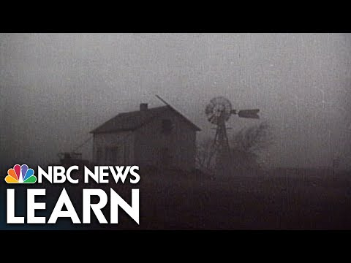
Ex: Dust Bowl

Slide 6
Urbanization
Definition: the process through which cities grow, and higher and higher percentages of the population comes to live in the city.
Impacts:
Natural habitats are lost when forests are cleared & wetlands are filled.
Construction causes the erosion of topsoil.
This is especially true in areas of high densities of people and supporting structures such as roads, homes, and buildings.
Soil and sediment can either be blown or washed away with rain, wind, movement, and disturbance (construction & deforestation).
Once soil is disturbed, the ground will lose strength and be unstable. This loss increases the potential for landslides.
Notes:
It will be easier to see the info on the slide if you present it. I have some animations.
Image: Lima, Peru

Slide 7
So… how can we reduce soil erosion?

Slide 8
Sustainable Agriculture and Soil Conservation
To reduce soil erosion…
No-till farming
Terracing
Contour farming
Windbreaks & Shelterbelts
Selective Logging

Slide 9
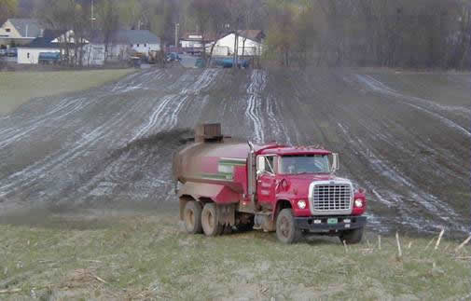
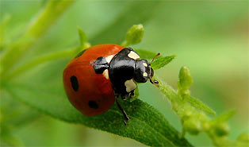
Sustainable Farming…
What is sustainable agriculture?
Techniques that attempt to conserve soil, recycle nutrients, & protect health
Includes: no till farming, natural pest control, & natural fertilizers
Also called organic farming.
Manure-spreading Truck
Beneficial Insect Predator
http://eartheasy.com/grow_nat_pest_cntrl.htm
http://www.usawaterquality.org/themes/npm/research/P_Organic.html

Slide 10
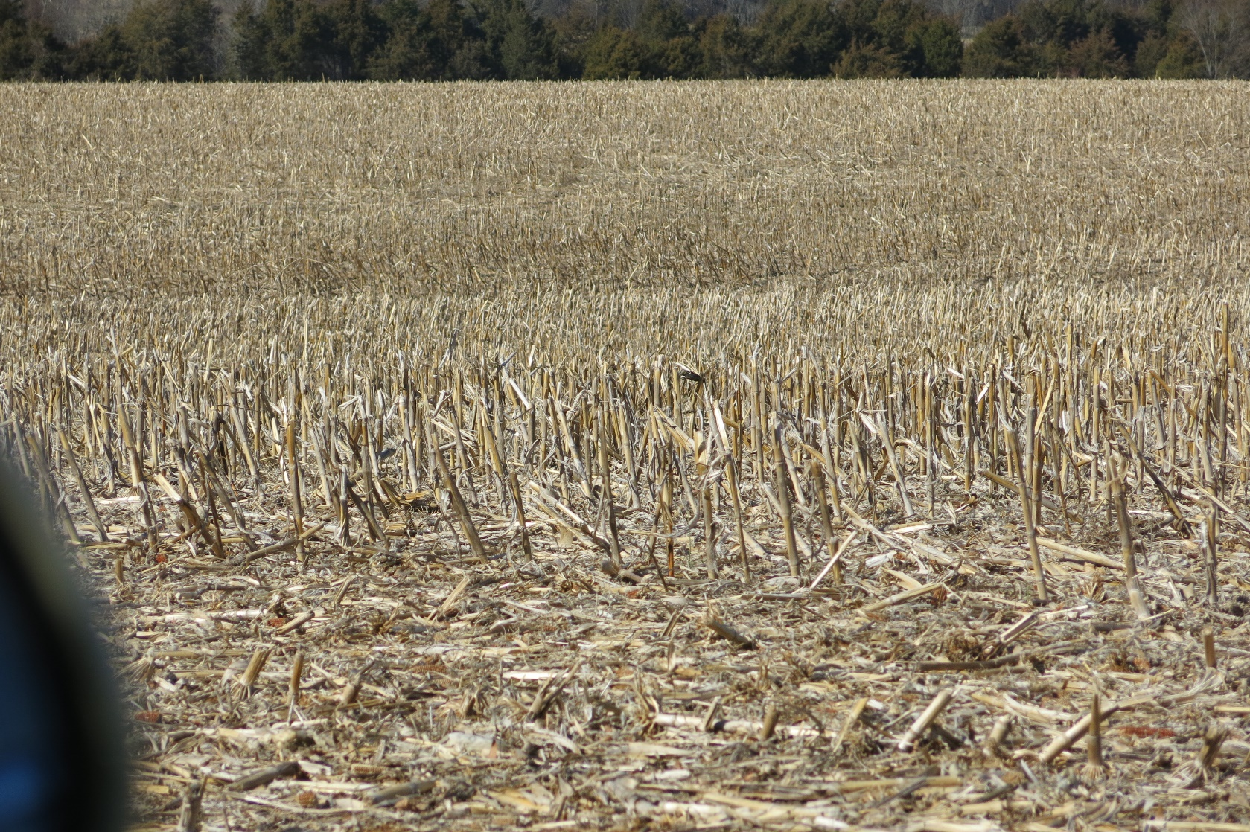
Reducing Erosion
Sustainable alternatives that help conserve topsoil: no-till farming (conservation tillage)
Notes:
Find more information here: https://forces.si.edu/soils/02_07_04.html
Find info on no-till farming and it’s advantages: https://notillagriculture.com/no-till-farming/advantages-and-disadvantages-of-no-till-farming/
video on plowing vs no till: https://www.youtube.com/watch?v=EwG4hqtn0VA

Slide 11
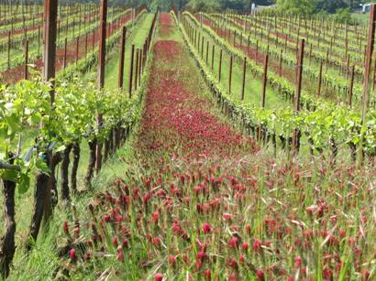
Reducing Erosion
Sustainable alternatives that help conserve topsoil: clover cover
http://www.extension.org/pages/31597/overview-of-vineyard-floor-management
Notes:
Article on the benefits of red clover as cover crop
https://www.youtube.com/watch?v=_kVLt2fZOqE

Slide 12
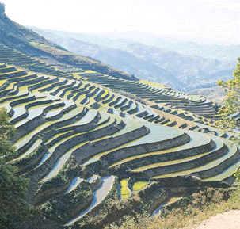
Reduce Erosion : Terracing
http://www.acca21.org.cn/image/p3-12.gif
Notes:
Article on benefits of terracing: https://www.no-tillfarmer.com/articles/1384-removing-terraces-from-no-till-cropland-not-recommended
Machu Picchu would be a great example/case study: https://www.smithsonianmag.com/history/farming-like-the-incas-70263217/
Video on Machu Picchu terracing: https://www.youtube.com/watch?v=cnMa-Sm9H4k
Video on Machu Picchu terracing (more about agricultural benefits): https://www.youtube.com/watch?v=qXKoJQ5Nx6s

Slide 13
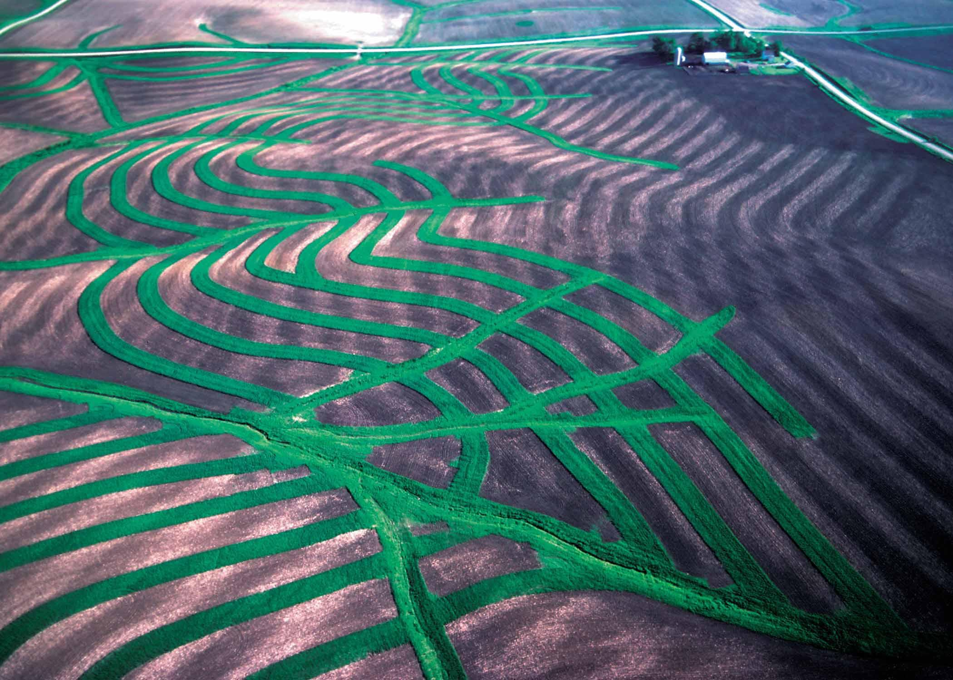
Reduce Erosion : Contour farming
http://www.ga.nrcs.usda.gov/programs/images/grassedwaterways.jpg
Notes:
Very similar to terracing and is usually coupled with terracing
Video: https://www.youtube.com/watch?v=62wEAbMH9uw
Article: https://www.gettingmoreontheground.com/2016/07/26/contour-farming-increases-soil-moisture/

Slide 14
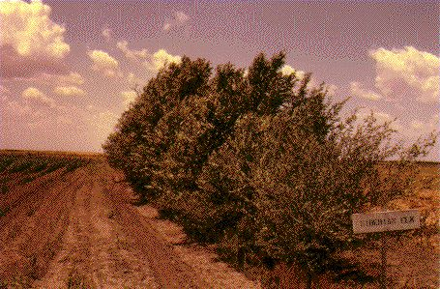
Reduce Erosion: Windbreaks and Shelterbelts
http://www.weru.ksu.edu/pics/control/1059.jpg
Notes:
Article: https://www.fs.usda.gov/nac/practices/windbreaks.php
Video: https://www.youtube.com/watch?v=FB2PD4PG5Yo

Slide 15
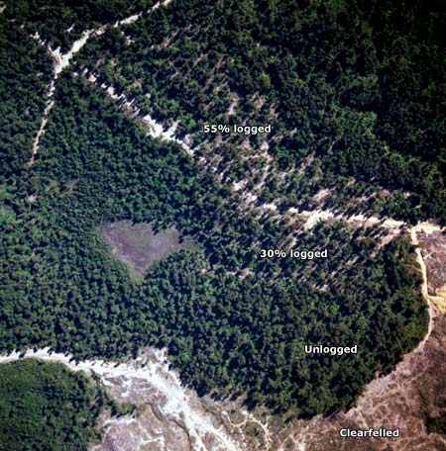
Reduce Erosion: Selective Logging
The impact of selective logging (taking only some trees from a forest) can be seen in this view of the Tīhoi state forest in 1976.
Above the logging road 55% of the timber has been removed, below it only 30% has been removed, while further down is an area of unlogged native forest.
Between 1975 and 1984, when selective logging was the only type of harvesting permitted in native forests, the Forest Service carried out trials to see if the damage it caused could be reduced.
http://www.teara.govt.nz/en/forestry-research/2/2

Slide 16
Development of this project was supported by:
Organization
Organization logo
Organization
Organization logo
For more information about the Center for Earth and Environmental Science and the Discovering the Science of the Environment program, go to:
https://cees.iupui.edu

