Slide 1

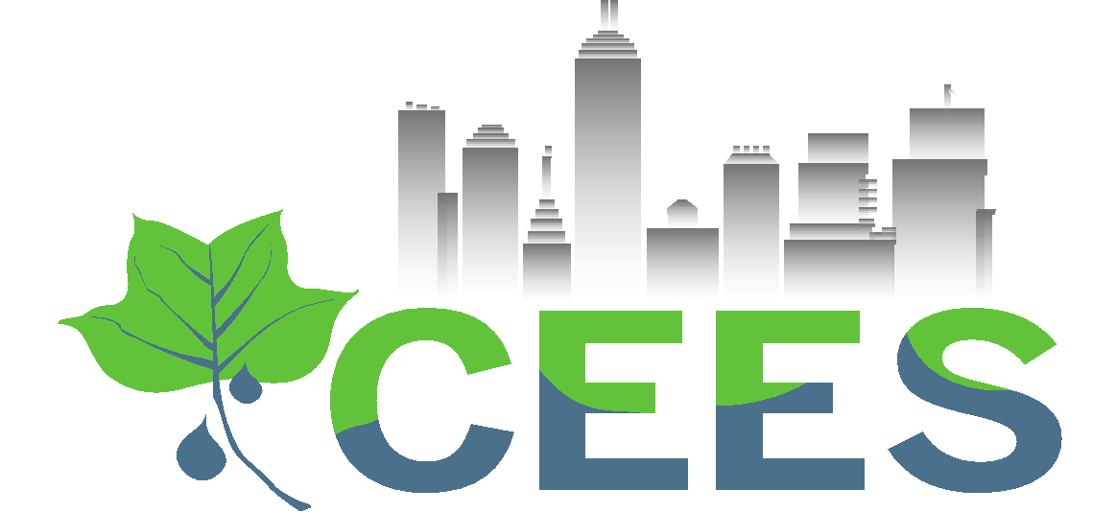
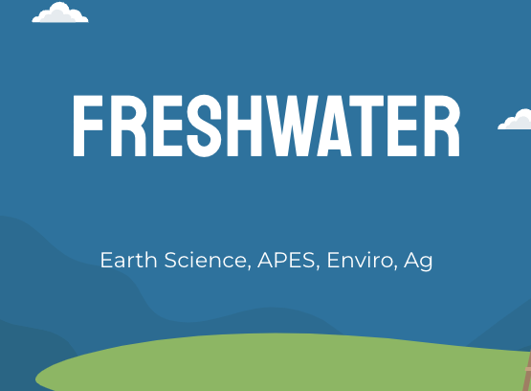
Discovering the Science of the Environment
Watersheds, Floodplains & Water Quality
Center for Earth and Environmental Science
with support from National Resource Conservation Service

Slide 2
Freshwater
Earth Science, APES, Enviro, Ag

Slide 3
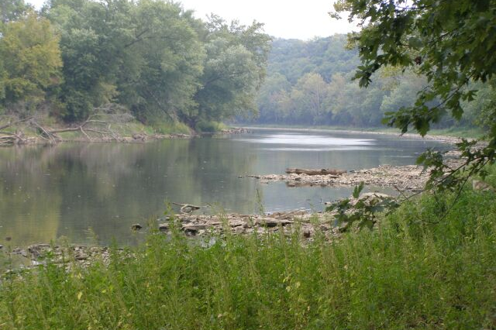
STREAMs and RIVERS
A stream is a body of water that flows through Earth’s surface.
A river is a synonym for stream but generally describes a larger body of water.
Streams form as a result of gravity and precipitation:
When precipitation occurs, much of the water flows across the surface downhill, collecting together and creating a stream.
East Fork of the White River in Indiana
Notes:
https://www.nationalgeographic.org/encyclopedia/stream/
https://www.nationalgeographic.org/article/understanding-rivers/

Slide 4
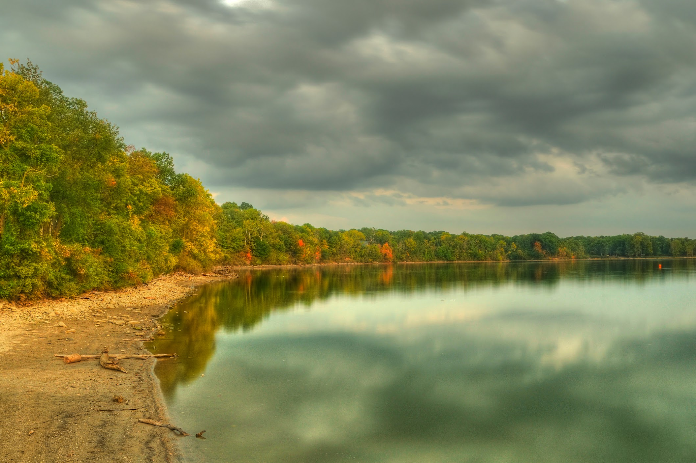
Lakes and Ponds
Both lakes and ponds are inland freshwater bodies of water that support biodiversity.
The major differences between the two relate to depth and surface area—lakes are deeper and wider than ponds.
These differences in size create different habitats within them.
Because ponds are smaller, they typically have standing water (no waves or flow) and uniform temperature. Light can also usually reach the shallow bottom, allowing plants to grow there.
Lakes are larger and generally have waves and/or flow. Temperatures can vary widely depending on the depth and location in the lake. They are also so deep that the bottom never receives light.
Eagle Creek Lake, Indianapolis, IN
Notes:
https://thewildclassroom.com/aquatic-biomes/lakes-and-ponds/
https://science.howstuffworks.com/environmental/earth/geophysics/lake-pond-difference.htm
https://www.lakescientist.com/lake-facts/how-lakes-differ/

Slide 5
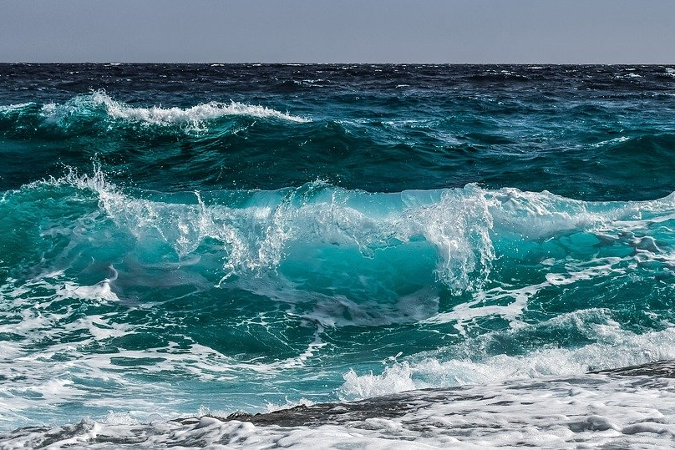
Oceans
Oceans are huge bodies of saltwater that cover 71% of Earth and make up 97% of all water on the planet.
Because of this, oceans heavily impact weather patterns, regional and global temperatures, and habitats.
Oceans play a big role in the carbon cycle, exchanging carbon with the atmosphere.
In fact, oceans absorb about 30% of human-caused carbon dioxide emissions
(insert carbon cycle with ocean)
Notes:
Ocean | National Geographic Society
https://archive.ipcc.ch/pdf/assessment-report/ar5/wg1/WG1AR5_Chapter03_FINAL.pdf

Slide 6
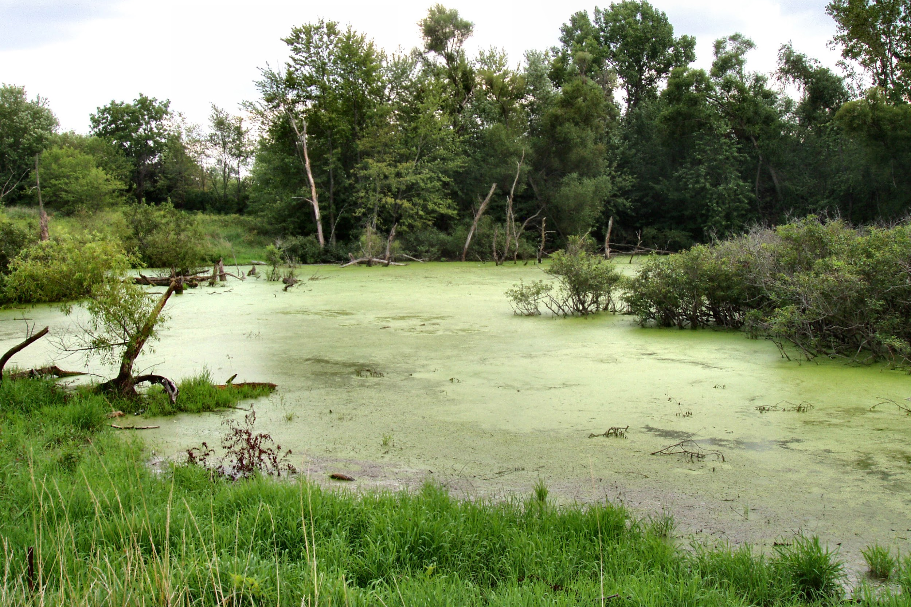
Wetlands
Wetlands are areas where water covers the soil, or where water exists at or near the surface of the soil. This water is present either year-round or for part of the year including the growing season.
Wetlands support both aquatic and terrestrial life, and can harbor unique species specially adapted for wetlands. This makes them very important for biodiversity.
Today, 3.5% of Indiana is covered with wetlands.
A wetland in Marshall County, IN
Notes:
https://www.fws.gov/wetlands/data/Water-Summary-Reports/National-Water-Summary-Wetland-Resources-Indiana.pdf
https://www.epa.gov/wetlands/what-wetland

Slide 7
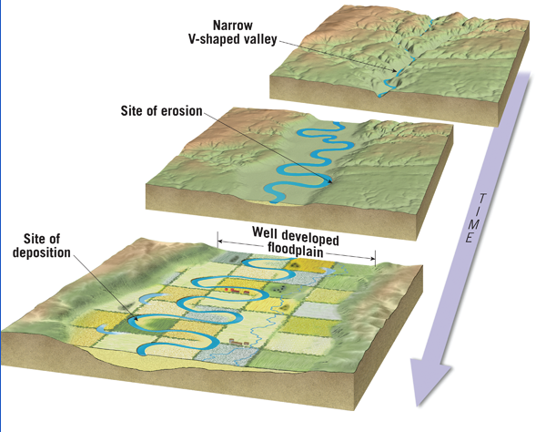
Floodplains
Floodplains
A river starts to flow through hills and valleys
Over time weathering and erosion break away the hills and widens the valley
As the river meanders it weathers and erodes sediments
When the river floods and overflows it banks it erodes even more - widening the valley into a floodplain

Slide 8
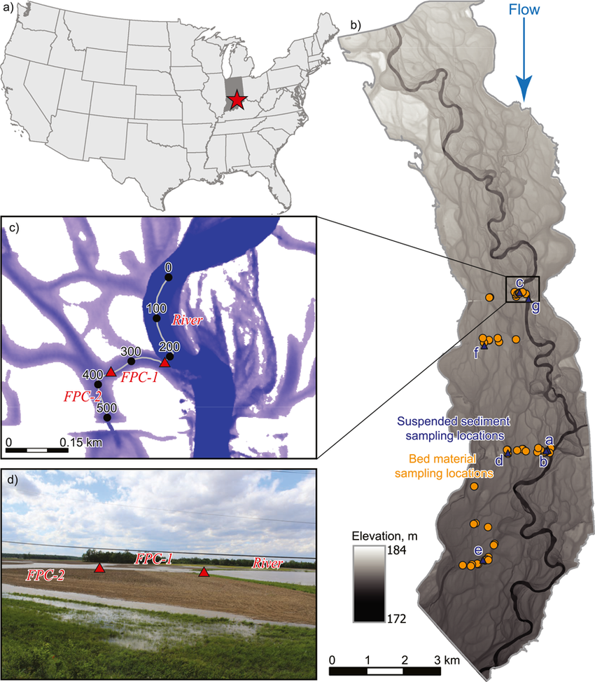
Floodplains along the White River
Floodplains are excellent sites of fertile soil and are often settled for agriculture
The river starts in a field in Randolph County and meanders through the state
Notice how wide the floodplain is.
This provides the state with very fertile soil, but planting in a floodplain has its risks and can affect water quality

Slide 9
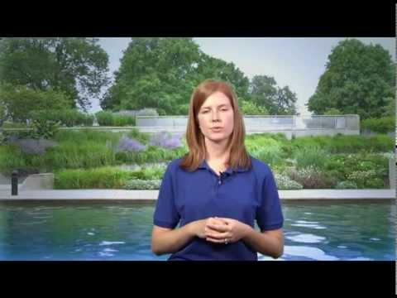
When precipitation falls onto the ground, much of it flows downhill across the surface as runoff and collects into streams.
A watershed is the area that collects water and flows into a specific stream or streams.
Watersheds are also called Drainage Basins.
Notes:
The four major matter cycles: water, nitrogen, phosphorus, carbon
https://www.nationalgeographic.org/encyclopedia/stream/

Slide 10
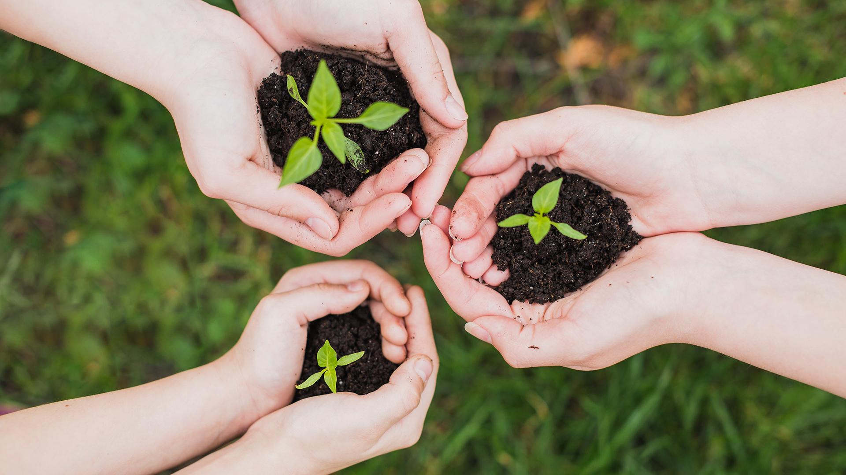
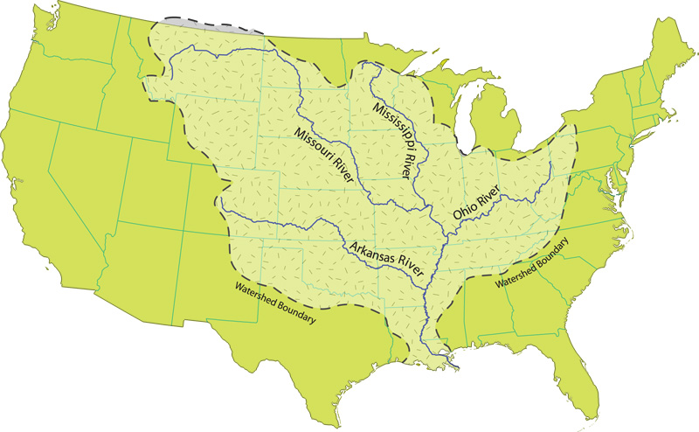
Mississippi Watershed
Notes:
FS_T5_L1_02_watersheds and irrigation lecture revised_E

Slide 11
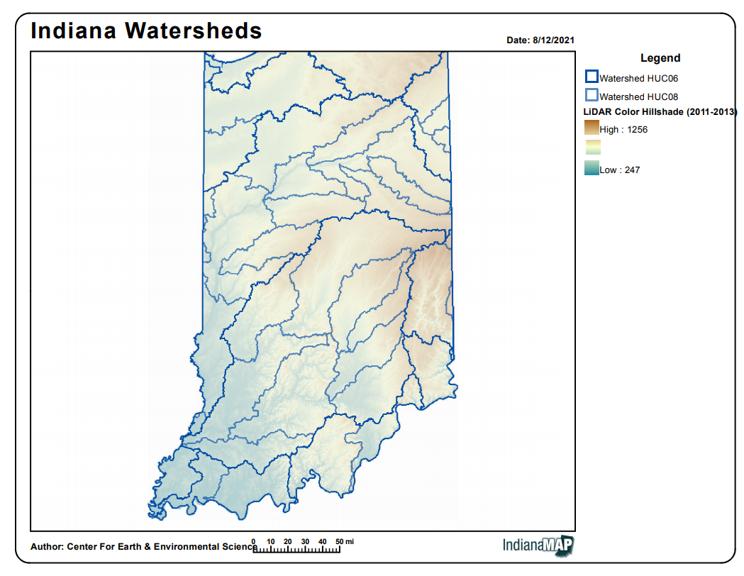

Slide 12
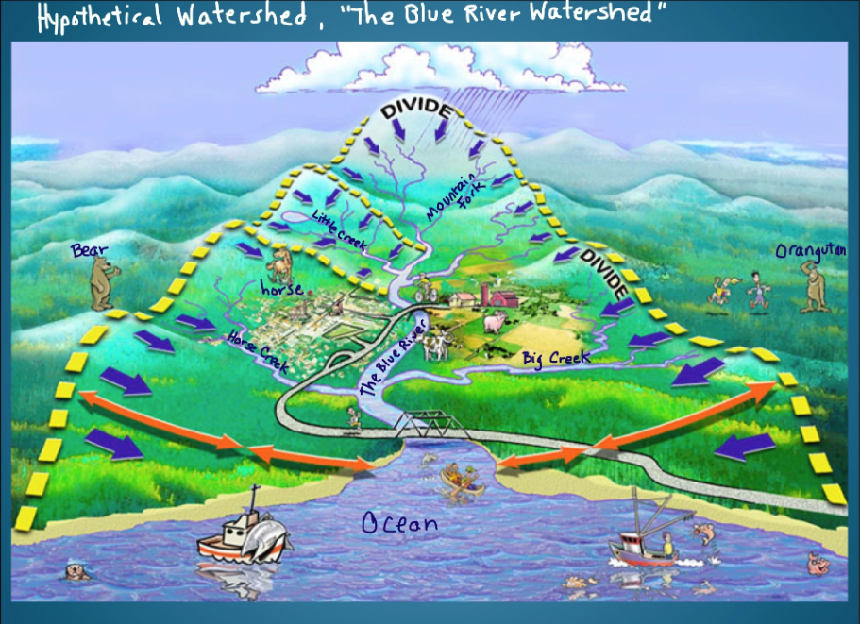
What is a Watershed?
Watershed - a land area that channels rainfall and snowmelt to creeks, streams, and rivers, and eventually to outflow points such as reservoirs, bays, and the ocean.
Tributary - a smaller river or stream that flows into a major river
What are the tributaries that flow into The Blue River?
Water flows _______?
If the bear dumps toxic waste, where will it end up?
Where will the farm waste end up?
If the city has an oil spill, where will it end up?

Slide 13
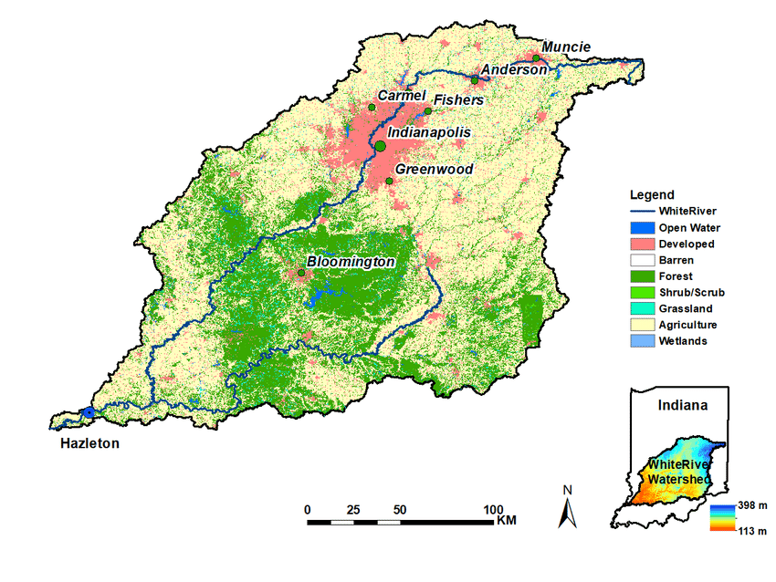
White River Watershed
What type of land do you notice in the White River Watershed?
How might this land impact the water quality of the White River?
How is your watershed?
https://mywaterway.epa.gov/community/46060/overview
What is the water quality of your part of the watershed?

Slide 14
Issues in Watersheds and water quality testing
Erosion & Sediments
Flooding
Eutrophication

Slide 15
Human Impact on the River
Temperature
pH (acidity)
Turbidity
Nitrogen & Phosphorus
Dissolved Oxygen
E. coli - bacteria

Slide 16
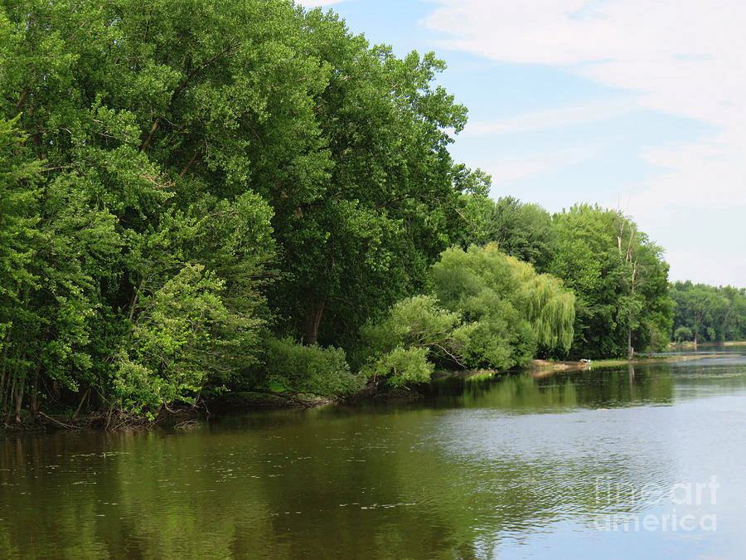
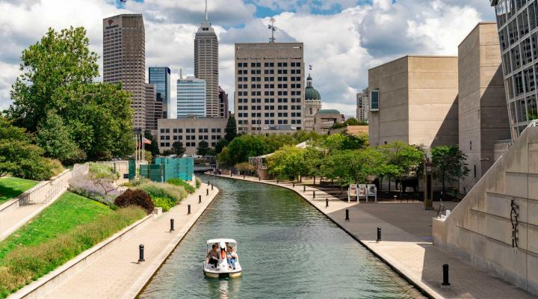
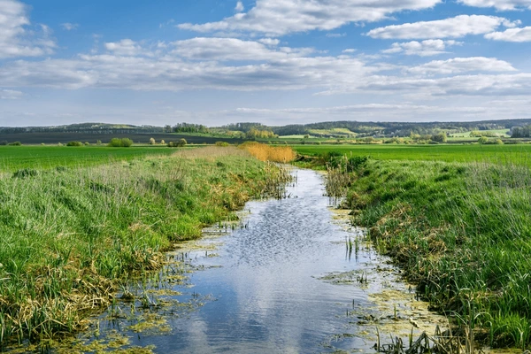
Temperature
Most Indiana species avoid water that is above 80 F
Many important invertebrate river species lay eggs in colder waters
Warm water doesn't hold oxygen as well
What can we expect the temperature to be at these locations?

Slide 17
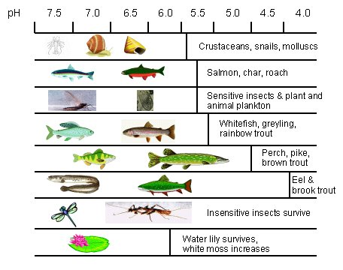
pH
Acid rain impacts the acidity of a river
Acid rain is formed from sulfur hydroxide from factory output and smog mixing with water to create sulfuric acid
Can impact the shells of mussels and crayfish
How will this impact humans?

Slide 18
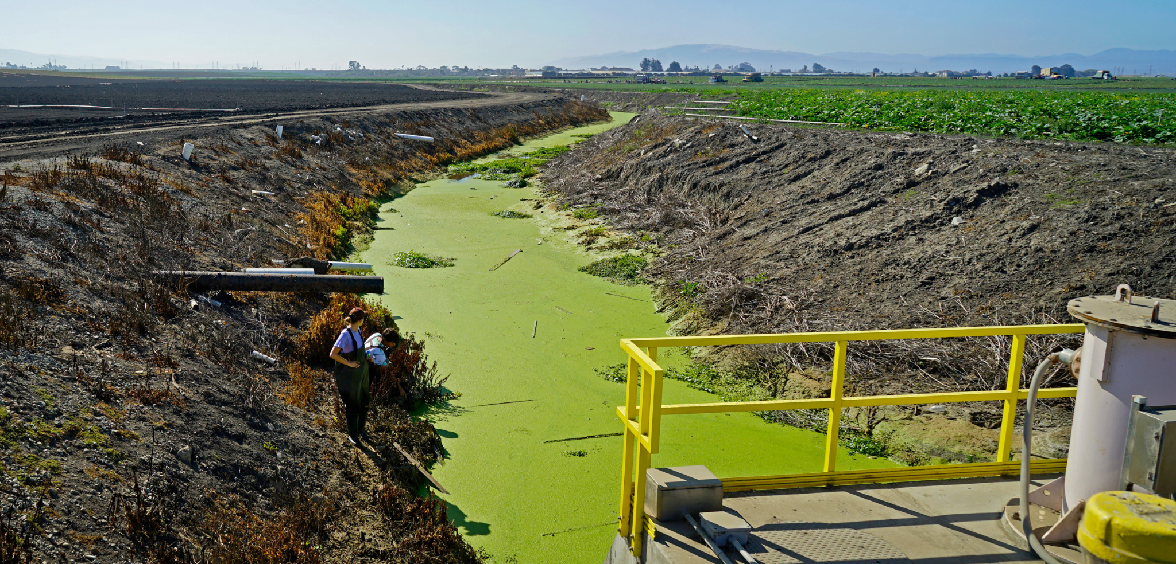
Nitrogen & Phosphorus
Nitrogen and Phosphorus are used in fertilizers
Gets in the water from farm fields, manure lagoons, golf courses, parks, fertilized lawns
When too much fertilizer is used it runs off the ground with the rain, into the storm drain and into the water
It’s fertilizer, so it’s going to fertilize the plants in the river…. This is bad…

Slide 19
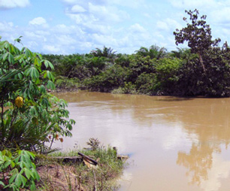
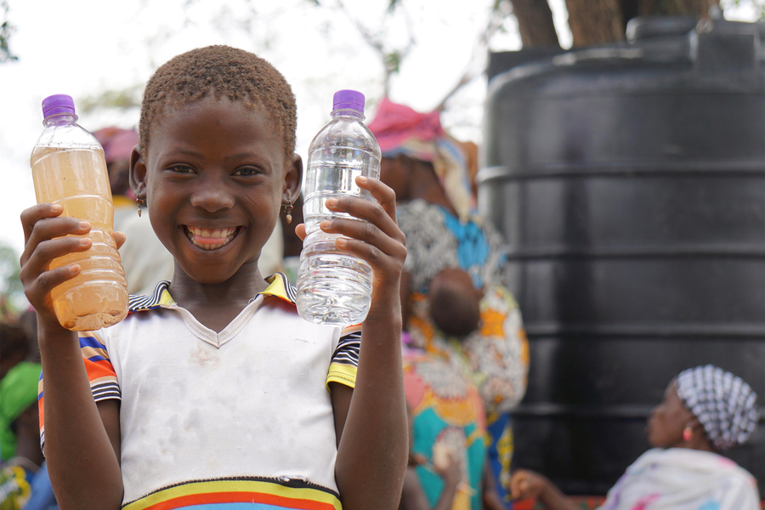
Turbidity
How “cloudy” the water is
Sediments in the water impact turbidity
How do sediments get in the water?
Clearing banks of trees, plants, wetland and swamp plants allows for sediments from roads, construction or fields to flow freely into the water system
Sediments in the water are harder to clean out at the water treatment plant
What is the impact of this on humans?
How do we decrease turbidity in water after a heavy rain?

Slide 20
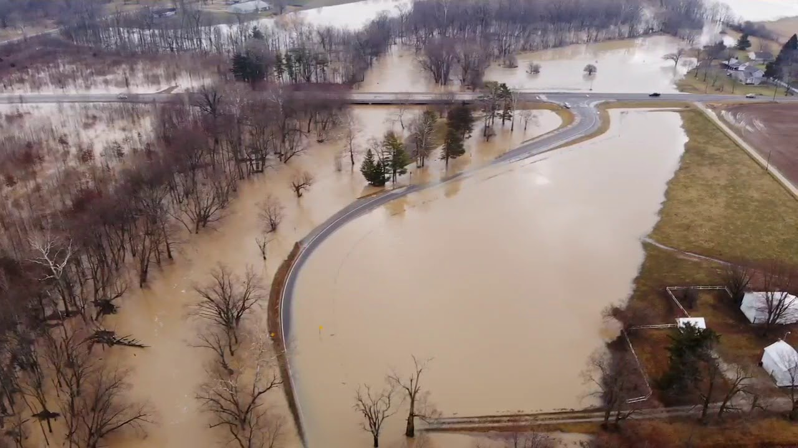
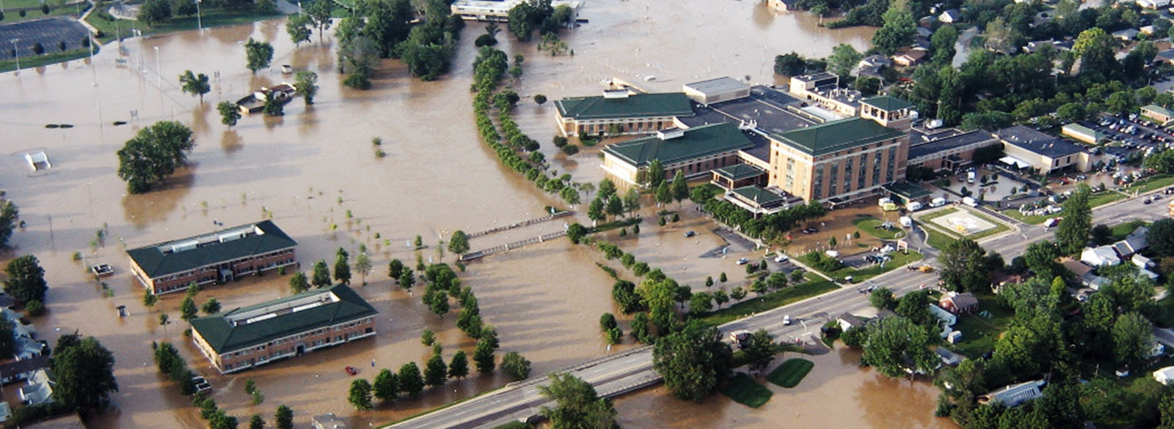
FloodPlains flood…
Will this issue get better or worse with climate change?

Slide 21
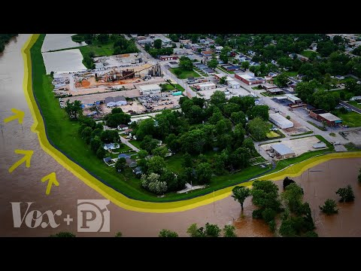
floodplains
Notes:
https://www.youtube.com/watch?v=qiVi-Bx9jWs
(levees and floodplains)
“Floodplains are often considered prime building locations. Development along river corridors has significantly altered floodplain functions, leading to more frequent and severe floods, extensive loss of fish and wildlife habitat, and greater risk to water supplies.”
https://www.nwf.org/Our-Work/Habitats/Floodplains

Slide 22
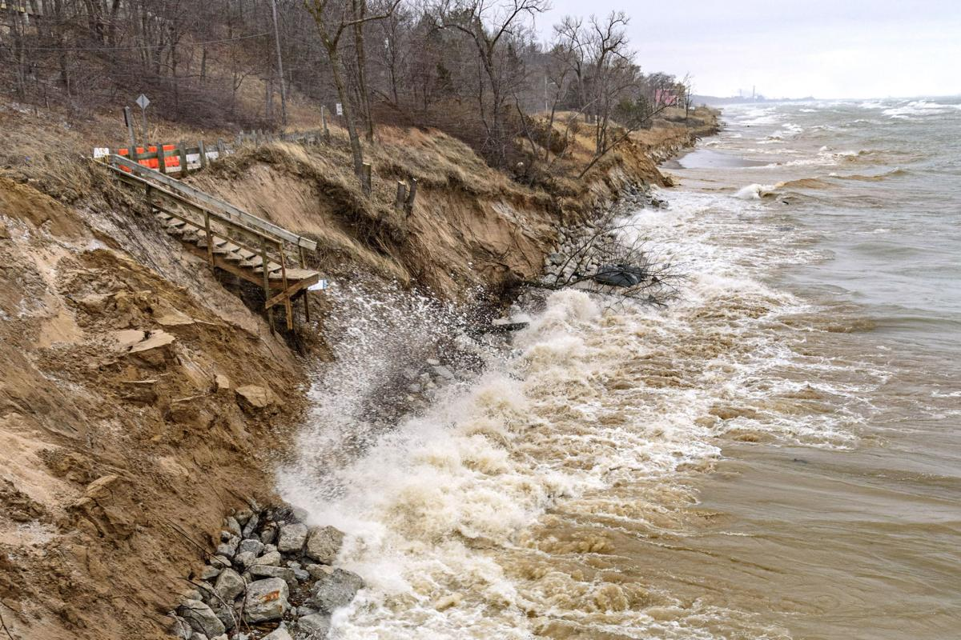
Water Erosion
Coastal water erosion in Northwest Indiana
Water causes most erosion on Earth. Water erosion is the process by which water physically moves or chemically dissolves rock and soil and “washes” it away. There are several different types of water erosion.
The biggest issue from water erosion is sediments in the water
Notes:
https://www.extension.purdue.edu/extmedia/AY/AY-228.html
https://www.agry.purdue.edu/soils_judging/new_manual/ch6-water.html

Slide 23
Sediments in the water
Sediments entering stormwater degrades the quality of water for drinking, wildlife, and the land surrounding streams in the following ways:
Sediments fill up storm drains and increase the potential for floods
Water polluted with sediments becomes cloudy, preventing aquatic animals from seeing food
Murky water prevents vegetation from growing in water (reduces light)
Sediments in stream beds disrupts the natural food chain by destroying the habitat where the smallest stream organisms live and causing massive declines in fish populations
Sediments increase the cost of treating drinking water
Sediments can clog fish gills, affecting fish health and development
Nutrients transported by sediments can promote HABs (harmful algal blooms) - including blue-green algae (cyanobacteria) that release toxins and can make swimmers sick

Slide 24
pollution Solutions!
No Till: By not tilling (breaking up) topsoil, old roots and vegetation in the ground from the previous harvest can hold onto soil and resist erosion.
Cover Crops: Secondary crops (i.e. kale, rye, alfalfa) planted after the harvest of primary crops (i.e. corn) improve soil health and hold onto soil, preventing erosion and filtering surface water until the next primary crop planting season.
Buffers: areas or strips of natural perennial vegetation (trees, bushes, grasses) between and around fields that slow down and filter surface runoff as well as promote biodiversity.
Permaculture: A broad approach inspired by indigenous practices to make agriculture more closely resemble natural ecosystems. This includes planting a variety of species of crops, no till, cover crops, buffers, and other practices.

Slide 25
How are humans affecting watersheds?
Notes:
Answer: A watershed is an area that collects water and deposits it into a stream, river, or other major body of water. This means that whatever nutrients or pollutants are present on the surface of an area and easily washed away will be transported by the watershed into the water ecosystem. Runoff from a bare or tilled field that uses fertilizer can cause eutrophication in a waterway by adding significant amounts of nutrients, especially phosphorus.
This relationship is nonpoint source.

Slide 26
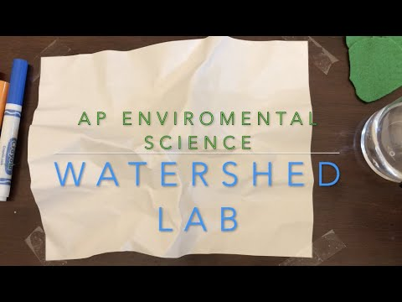
Watershed Lab
Notes:
This video shows the entire lab, including outcome. Teachers may want to show the set up to clarify and stop it before the water spray.

