Slide 1



Discovering the Science of the Environment
The Water You Eat & Water Conservation
Module Introduction
Center for Earth and Environmental Science
with support from National Resource Conservation Service

Slide 2
Why should we care about water?
Notes:
A great way to get students involved and thinking about water is to have them do a water audit.
We are going to take time to do a 24 hour water audit and talk about some of the things we use water on that you (or students) might not think about

Slide 3
Potential Discussion Questions
Have students write down everything they think uses water
Why is water important for habitability? For survival?
Does water really recycle in the water cycle? Does it get stuck anywhere? What happens when it doesn’t rain?
Should we conserve water? Why?

Slide 4
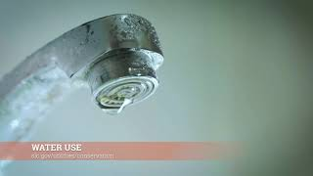
Water usage Public service announcement

Slide 5
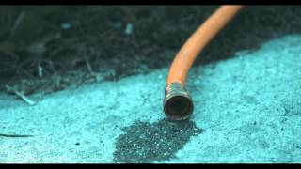
Water conservation Public service announcement

Slide 6
How and Where Do we use our water:
what is covered in these PSA?
What is missing?

Slide 7
How and Where Do we use our water:
So you take a three minute shower to save 5 minutes of water usage (60 Liters)
It's been a rough morning and the short shower
Didn’t wake you up….
You drink two cups of coffee….what just happened?

Slide 8
How and Where Do we use our water:
How many liters of water is needed to produce
A cup of coffee?
140 liters per cup
280 liters for two cups
After saving 60 liters in the shower…..

Slide 9
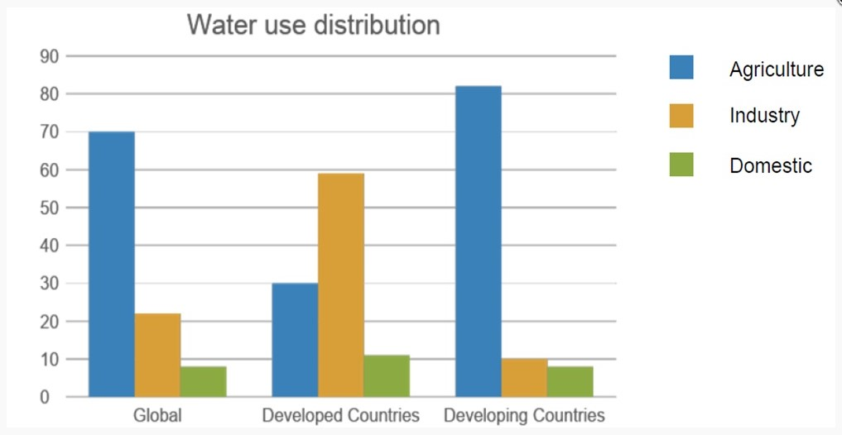
How and Where Do we use our water:
Source: Cropaia.com

Slide 10
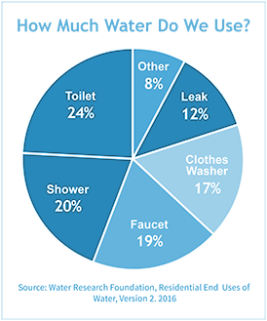
Personal use
Personal water use only accounts for 12% of total water use in the United States (EPA, 2010).
What are some ways you can manage your household water use?

Slide 11
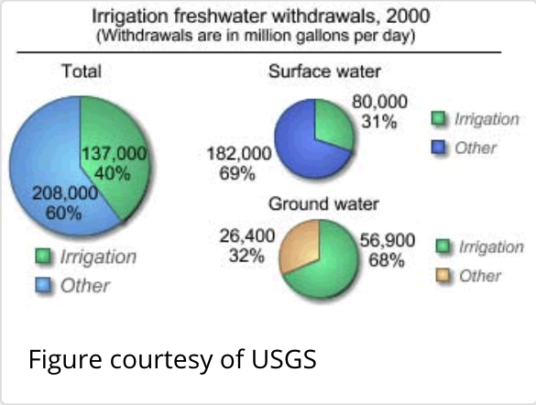
Agriculture
What are things farmers might need to use water for?
A study from Minnesota looked at the water use of CAFOs (concentrated animal feeding operations) and found that 34% of CAFOs (combined) used up to 1 billion gallons of water per year. Only 34% of CAFOs obtained water use permits; water use of the 66% of CAFOs that did not obtain permits could not be evaluated.
This water is pulled from local watersheds and aquifers.
What happens to the water that is done being used?
What effects does a CAFO have on a watershed?
Notes:
https://scholarworks.umt.edu/etd/11365/

Slide 12
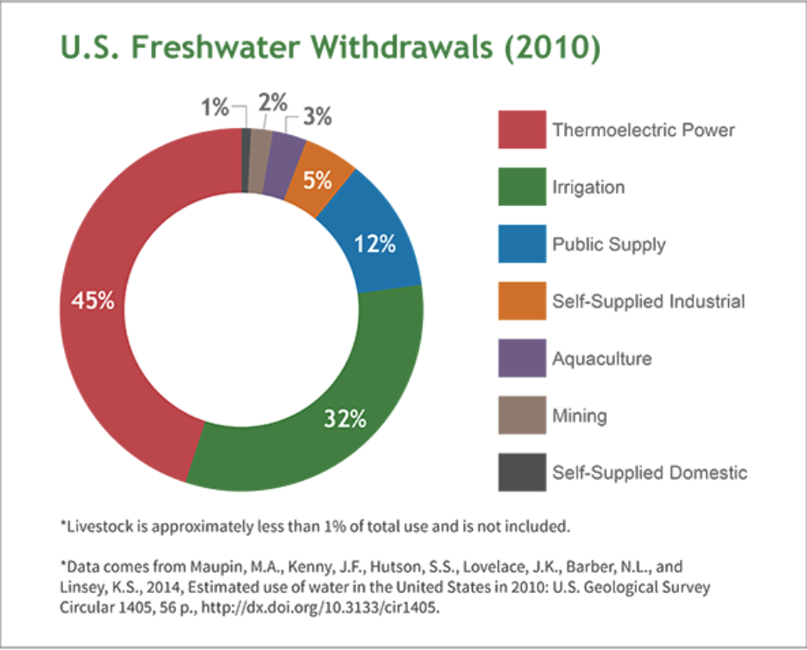
INdustry
Cars - 39,090 gallons of water are required.
One Tire = 518 gallons of water
Clothing
To create a pair of blue jeans, about 1,800 gallons of water are needed just to grow enough cotton for one pair. To grow enough cotton to create one t-shirt, 400 gallons of water are consumed. These totals are just for growing the cotton – creating cotton fabric, constructing the clothing, and other factors are not accounted for, but do add to the water footprint to each clothing item.
It takes about 2,257 gallons of water to make one pair of shoes. To make a pound of synthetic rubber, used for shoe soles, 55 gallons of water are needed.

Slide 13
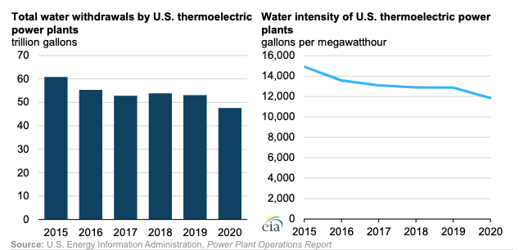
Water and Electricity
Water use in electricity and powerplants is becoming more efficient
But still uses a lot of water!
Water is used to cool systems - water is not needed in the use of solar or wind power.

Slide 14
If personal use is only 12% of water used
In the usa, we are off the hook right?
Our choices lead to demand in the
Agriculture, industry and electricity sectors
Our virtual water use leads to huge
Water use we don’t see

Slide 15
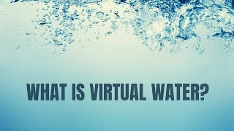
What is virtual water?
It is the water used to produce
The products we consume…
Slide 20

Slide 16
What is virtual water?
Two useful tools/resources for you
Water Footprint Calculator
https://www.watercalculator.org/wfc2
Water Footprint Calculator Food Guide
https://www.watercalculator.org/water-footprint-of-food-guide/
Water We Eat
https://thewaterweeat.com/
We won’t use these websites today due to time constraints, but they are useful!

Slide 17
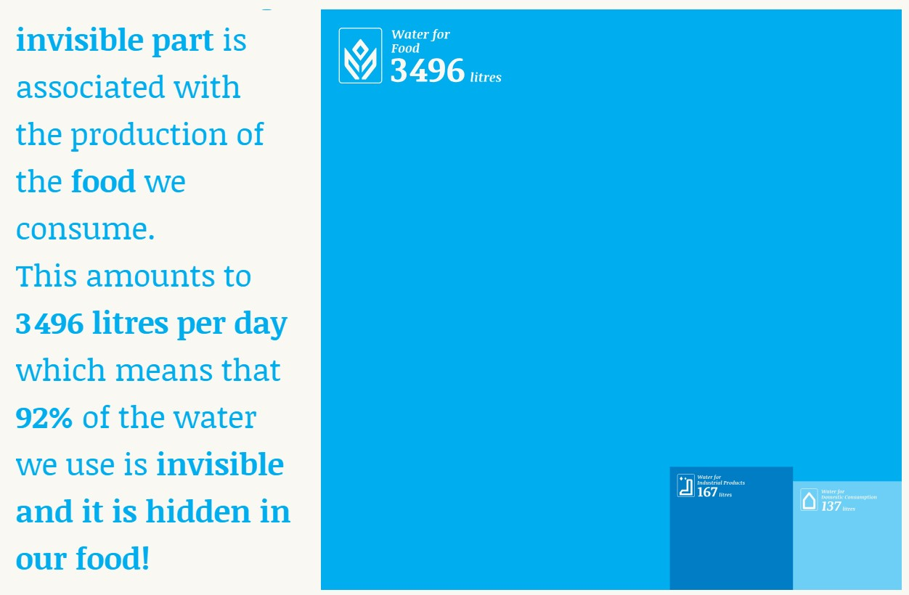
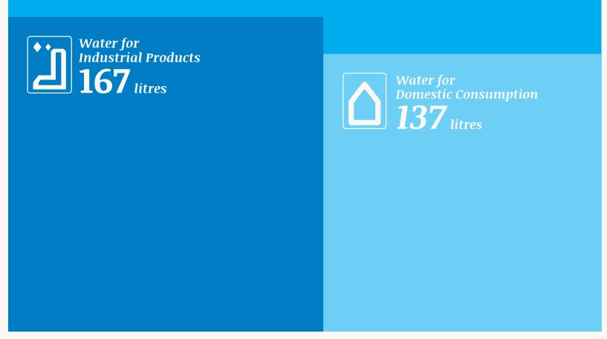
What is virtual water?

Slide 18
What is virtual water?
How does one hamburger (4 oz) contain
463 gallons (1746 liters!) of water?
This comes from cows! The water is from:
Water used to grow (and sometimes irrigate)
the cow’s food
Water the cow drinks over its life
Water used to process the meat

Slide 19
What is virtual water?
Tomorrow (Today) we will go through a typical meal for
You…..write down your favorite meal now
Or write down what you eat for dinner tonight

Slide 20
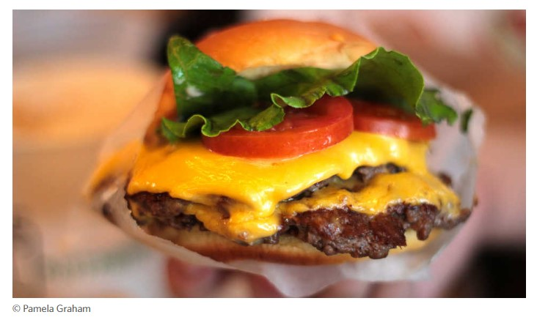
How much water do you eat?
California Academy of Sciences Activity (Clickable Link)

Slide 21
How much water do you eat?
We will first look at making a healthy meal…..
Use the cards in front of you to make what you
Think is a balanced and healthy meal….

Slide 22
How much water do you eat?
It might be a healthy meal…but is it water smart?
Turn over your cards to see how much water
Was used to make your “healthy” meal

Slide 23
How much water do you eat?
think of an ideal
Meal or favorite meal
Then calculate the virtual water
come up with lower water alternatives

Slide 24
How much water do you eat?
Water footprint food guide is a good place to find virtual water content for many common food items
Water footprint food guide
How much water in our lunches? Let's find out!

Slide 25
How much water do you eat?
Lets share!
How much virtual water in your lunch?
What were the water intensive items?
Did you find any good websites or apps for finding virtual water content?

